Slide 1
OSHA for Dental Providers
Sarah Stream, MPH, CDIPC, CDA, FADAA
Monday, June 05, 2023

Slide 2
disclosures
No relevant financial disclosures
All brands mentioned are for educational purposes

Slide 3
Learning objectives
Discuss the need for OSHA compliance in the dental setting
Identify OSHA Hazard Communications Standard and employer requirements
Identify OSHA Bloodborne Pathogens Standard and employer requirements
Identify OSHA Respiratory Protection Standard and employer requirements
Discuss high risk areas in the dental setting and mitigation strategies to keep your employees safe

Slide 4
Who has authority?
Patient Safety
Employee Safety
Dental Board
Dept. Public Health
FDA
OSHA

Slide 5
What is OSHA?
Regulatory agency
Protects employees against physical, chemical, and infectious hazards in the workplace
Establishes protective standards, enforces those standards, and offers technical assistance and consultation programs
OSHA is a federal agency, but 22 states administer their own state-operated OSHA programs
In states that administer their own OSHA programs, the state standards must be equivalent to or more stringent than those of the federal agency

Slide 6
Why are osha requirements important?

Slide 7
Dentistry is an extremely hazardous profession

Slide 8
Potential hazards in Dentistry
Infectious Hazards
Psychological Hazards
Physical Hazards
Chemical Hazards
Radiation Hazards

Slide 9
OSHA and dentistry
No specific OSHA standards for dentistry
However…
The risk of exposure to biological, chemical, environmental, and physical workplace hazards that may apply to dentistry are addressed in specific OSHA standards for general industry
Notes:
Who is exempt from OSHA? | OSHA Legal
SELF EMPLOYED WORKERS – FULL EXEMPTION
Under the OSH Act, the term “employer” means that a “person” is engaged in business and has employees.
That is to say that business owners with no employees are generally not subject to the OSHA, whereas business owners with one or more employees generally are subject to the OSHA. This is true even if the business owner that has employees operates his or her business as a sole proprietorship without the use of a formal business entity, such as corporation, LLC, etc.
EMPLOYERS WITH TEN EMPLOYEES OR LESS – PARTIAL EXEMPTION
Employers who have ten or fewer employees have a partial exemption from OSHA’s extensive record-keeping requirements. These employers are not required to keep OSHA injury and illness records unless OSHA mandates explicitly for this. However, these employers are nevertheless required to report any workplace injuries or fatalities.
Discuss?
In light of the COVID-19 pandemic, OSHA recently modified this rule, mandating that all employers report the number of confirmed COVID-19 cases among workers at the workplace. Employers are responsible for reporting cases of COVD-19 if the following are met:
The case is a confirmed case of COVID-19 as provided by the CDC
The case is work-related; and
The case involves one or more of the following general criteria: days away from work, restricted work or transfer to another job, loss of consciousness, medical treatment beyond first aid, or death.

Slide 10
Who is covered by OSHA?
Private Sector Workers:
OSHA covers most private sector employers and workers in all 50 states, the District of Columbia, and other U.S. jurisdictions either directly through Federal OSHA or through an OSHA-approved state plan. State-run health and safety programs must be at least as effective as the Federal OSHA program. To find the contact information for the OSHA Federal or State Program office nearest you, see the Regional and Area Offices map.
State and Local Government Workers:
Workers at state and local government agencies are not covered by Federal OSHA but have OSH Act protections if they work in one of the states or territories that have an OSHA-approved state program.
Federal Government Workers:
OSHA's protection applies to all federal agencies. Federal agencies must have a safety and health program that meet the same standards as private employers. Although OSHA does not fine federal agencies, it does monitor these agencies and conducts federal workplace inspections in response to workers' complaints.
https://www.osha.gov/workers

Slide 11
https://www.osha.gov/stateplans

Slide 12
Who is exempt?
SELF EMPLOYED WORKERS – FULL EXEMPTION
Business owners with no employees are generally not subject to the OSHA, whereas business owners with one or more employees generally are subject to the OSHA. This is true even if the business owner that has employees operates his or her business as a sole proprietorship without the use of a formal business entity, such as corporation, LLC, etc.
EMPLOYERS WITH TEN EMPLOYEES OR LESS – PARTIAL EXEMPTION
Employers who have ten or fewer employees have a partial exemption from OSHA’s extensive record-keeping requirements. These employers are not required to keep OSHA injury and illness records unless OSHA mandates explicitly for this. However, these employers are nevertheless required to report any workplace injuries or fatalities.
https://www.osha.gov/workers

Slide 13
Who is responsible for temporary employees?
Employer responsibility
To ensure that there is a clear understanding of each employer's role in protecting employees, OSHA recommends that the temporary staffing agency and the host employer set out their respective responsibilities for compliance with applicable OSHA standards in their contract.
OSHA could hold both the host and temporary employers responsible for the violative condition(s) - and that can include lack of adequate training regarding workplace hazards. Temporary staffing agencies and host employers share control over the worker and are therefore jointly responsible for temporary workers' safety and health.
https://www.osha.gov/temporaryworkers/

Slide 14
Osha can audit any practice
This Photo by Unknown Author is licensed under CC BY-SA
If they audit, they will want records from the last 3 years.

Slide 15
Investigation process
Letter inquiring about the hazard
Employer is required to respond within 5 working days
Complaints considered serious are followed up on within 30 days
Unannounced visit (opening conference, walk-through, closing conference)

Slide 16
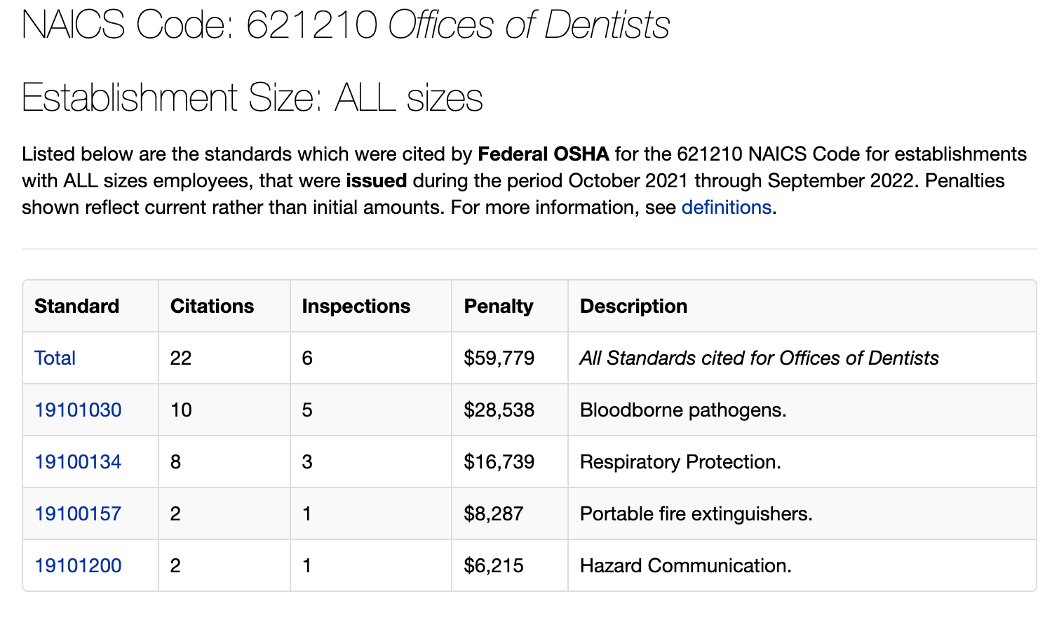
https://www.osha.gov/ords/imis/citedstandard.naics?p_esize=&p_state=FEFederal&p_naics=621210

Slide 17
Staying audit ready
Appropriate policies
Appropriate training
Regular assessment of plan
Correct labeling and signage
Updates incorporated

Slide 18
OSHA Bloodborne Pathogens Standard
Standard 1910.1030

Slide 20
OSHA BBP Standard
Title 29 of the Code of Federal Regulations at 29 CFR 1910.1030
The standard’s requirements state what employers must do to protect workers who are occupationally exposed to blood or other potentially infectious materials (OPIM), as defined in the standard
The standard protects workers who can reasonably be anticipated to come into contact with blood or OPIM as a result of doing their job duties
Notes:
All of the requirements of OSHA’s Bloodborne Pathogens standard can be found in Title 29 of the Code of Federal Regulations at 29 CFR 1910.1030

Slide 21
What are Bloodborne Pathogens?
Bloodborne Pathogens (BBPs) are microorganisms and bacteria that are present in human blood or body fluids and can cause sickness and sometimes death.
BBPs may also be found in other potentially infectious materials (OPIM)
The Hepatitis B virus, (HBV) Hepatitis C virus, and Human Immunodeficiency Virus (HIV) are all examples of BBPs.
https://www.osha.gov/pls/oshaweb/owadisp.show_document?p_id=10051&p_table=STANDARDS

Slide 22
Body fluids to which standards apply UP= Universal precautions (OLD) BBP=Bloodborne Pathogens Standard SP=Standard precautions
https://www.osha.gov/bloodborne-pathogens/worker-protections

Slide 23
BBP Written Plans
Establish an Exposure Control Plan
Written plan to eliminate or minimize occupational exposures
Review and update the plan:
At least annually
Whenever new or modified tasks/procedures affect occupational exposure
New/revised employee positions with occupational exposure
Required elements:
Exposure determination
Identify job classifications with occupational exposure to blood or OPIMs
Review tasks and procedures for occupational exposure potential; reevaluate when new processes or procedures are introduced
Schedule and method of implementation
Methods of compliance [29 CFR 1910.1030(d)]
Hepatitis B vaccination and post-exposure evaluation and follow-up [29 FR 1910.1030(f)]
Communication of hazards to employees [29 CFR1910.1030(g)
Recordkeeping [29 CFR 1910.1030(h)]
https://www.osha.gov/sites/default/files/publications/OSHA3696.pdf

Slide 24
Policies included in BBP Plan
Standard Precautions
Engineering Controls
Sharps safety (including instrument transport)
Work Practice Controls
Housekeeping
Waste disposal
Laundry
Handwashing
PPE usage
Hepatitis B Vaccination
Exposure management
Employee Training Requirements
Recordkeeping
https://www.osha.gov/sites/default/files/publications/OSHA3696.pdf

Slide 25
Minimizing Employee Exposure
Engineering Controls: Physical things that we use to minimize our exposure when performing our job duties
Work Practice (Administrative) Controls: Policies and procedures that are in place to minimize our exposure when performing our job duties
https://www.osha.gov/pls/oshaweb/owadisp.show_document?p_id=10051&p_table=STANDARDS

Slide 26
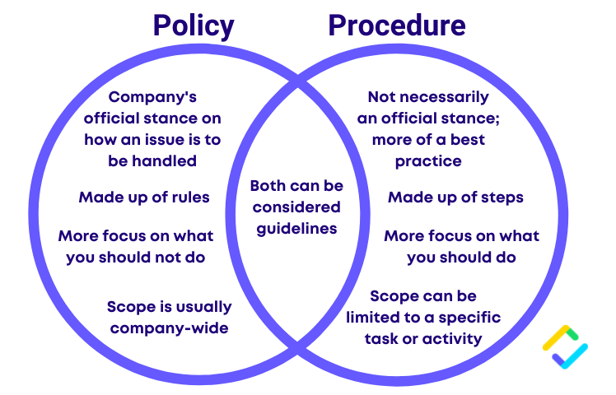
What and Why
How, Who, When
https://safetyculture.com/topics/policies-and-procedures/

Slide 27
Standard precautions
Standard Precautions (Universal Precautions)
Used in all healthcare settings for all patient care interactions
Treat everyone as if they are infectious
Things to include in Standard Precautions Plans:
Hand hygiene policy
PPE selection policy
Safe injection practices
Exposure incident protocols
Standard sterilization and disinfection of patient care equipment, instruments and environmental surfaces
https://www.cdc.gov/infectioncontrol/basics/standard-precautions.html

Slide 28
Reservoir
Portal of Exit
Mode of transmission
Portal of Entry
Susceptible Host
Infectious Pathogen
Chain of
Infection

Slide 29
Sharps Safety
This Photo by Unknown Author is licensed under CC BY
Sharps include: anesthetic needles, scalpel blades, wires and broken glass
Policy Considerations:
Never recap a needle or blade with your hands, use a needle recapping device or the scoop method
Never handle sharps with your hands, use other means to pick them up or transport them
Evaluation of devices on an annual basis
This Photo by Unknown Author is licensed under CC BY
https://www.cdc.gov/injectionsafety/one-and-only.html
This Photo by Unknown Author is licensed under CC BY-SA-NC

Slide 30
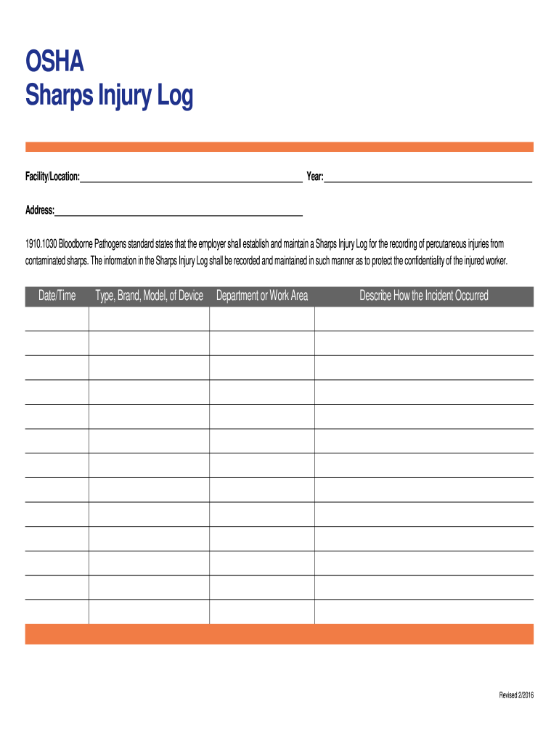
Sharps injury log
Tracks devices, not people
Surveillance tool
Filed in OSHA binder
Should be regularly reviewed for trends and influence sharps safety decisions
If no injuries occur, you much document yearly
https://sharps-injury-log.pdffiller.com/

Slide 31
Sharps Safety Devices

Slide 32
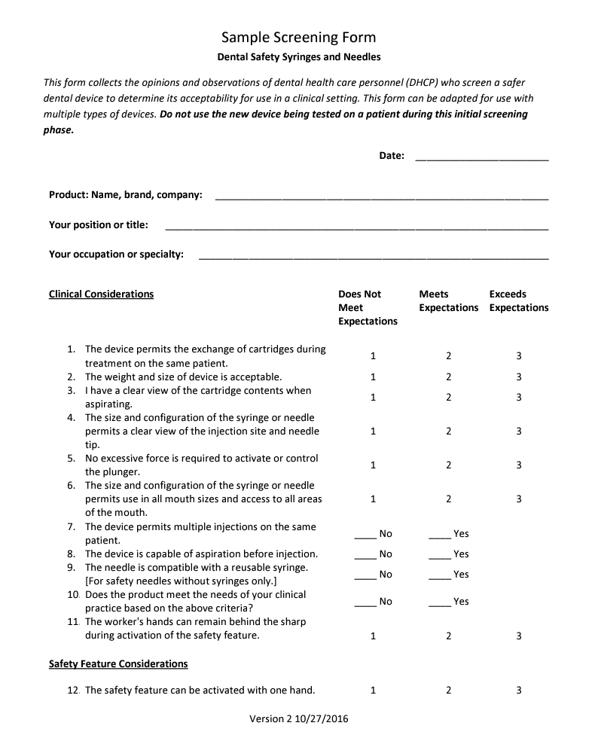
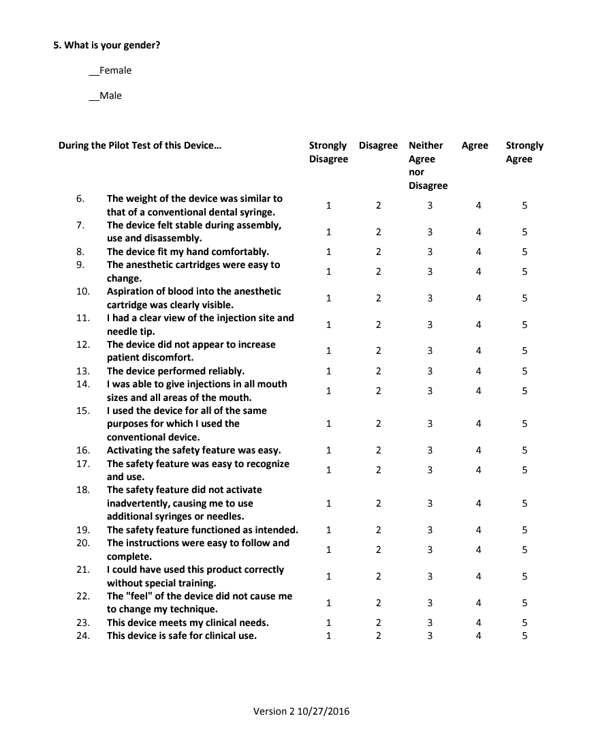
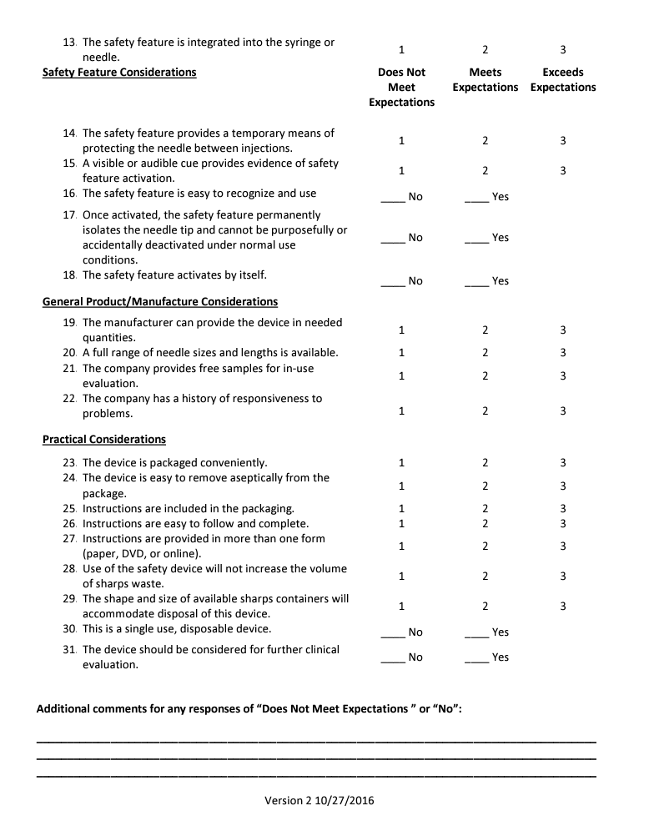
Evaluation of sharps safety devices
https://www.cdc.gov/oralhealth/infectioncontrol/forms.htm

Slide 33
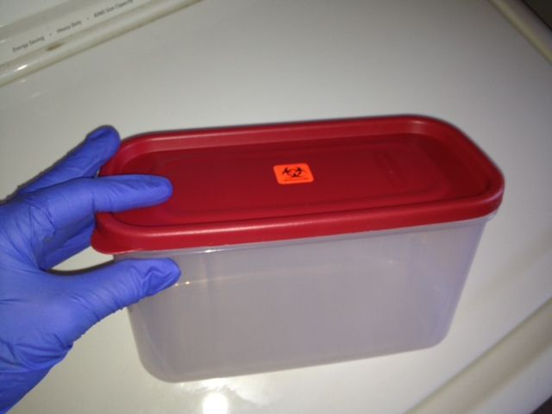
Instrument transport
OSHA requires instrument transport container for sharp instruments
Puncture proof
Leak proof
Latchable/ Lockable
Biohazard Label

Slide 34
housekeeping
Clinical and Household surfaces
Regular cleaning schedules
Include responsibility

Slide 35
Waste disposal: Types of waste
General (non-regulated)
Housekeeping
Non-infectious
Garbage
Hazardous
Biohazardous
Sharps
Regulated
Chemical
Infectious and Dripping
Human Tissue
Infectious or Not
Dangerous to Humans

Slide 36
Waste disposal
ANY regulated waste should be placed in a closeable, leakproof, puncture resistant container with the appropriate labels
Hazardous waste must be disposed of according to local and federal regulations
Biohazardous waste must be disposed of according to local and federal regulations
Sharps must be disposed of according to local and federal regulation
https://www.osha.gov/pls/oshaweb/owadisp.show_document?p_id=10051&p_table=STANDARDS

Slide 37
Contaminated Laundry
Standard 1910.1030 d 3 iv
Employees may not take contaminated protective clothing off site
Must be laundered on site or with a laundry service (preferred)
Must be bagged in a Biohazard Container for laundry service
Tips
Use the hottest water possible
A biohazard sticker should be placed on the washing machine as it potentially contains contaminated clothing

Slide 38
Hand Hygiene
The most important thing you can do to prevent the spread of disease in your office

Slide 39
When should you practice hand hygiene?
Use of Hand Sanitizer | Wash with Soap and Water
Immediately before touching a patient | When hands are visibly soiled
Before performing and aseptic task or handling invasive medical devices | After caring for a person with known or suspected diarrhea
Before moving from work on a soiled body side to a clean body site on the same patient | After known or suspected exposure to spores (C.diff)
After touching a patient or the patient’s immediate environment
After contact with blood, body fluids or contaminated surfaces
Immediately after glove removal
https://www.cdc.gov/handhygiene/providers/index.html
Notes:
Some facilities allow staff to wash in the sink where decontamination happens. This is not allowed. Hand hygiene sinks must be dedicated to hand hygiene only. How many of you knew that?

Slide 40
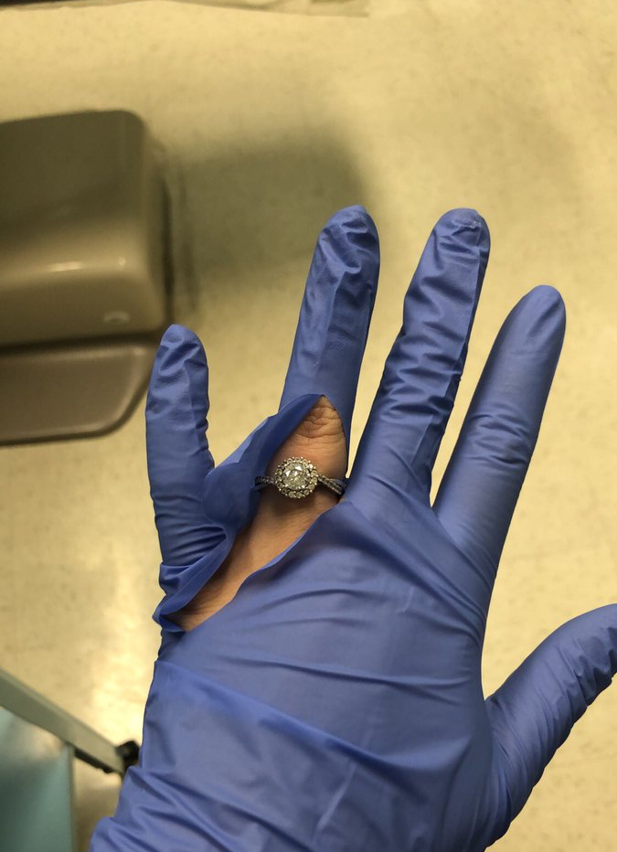
Fingernails and Jewelry
Pathogens can live under nail polish, gel polish and artificial fingernails both before and after using an alcohol-based hand sanitizer and handwashing
It is recommended that healthcare providers do not wear nail polish, gel polish and artificial fingernails or extensions when having direct contact with patients
Keep natural nail tips less than ¼ inch long
Some studies have shown that skin underneath rings contains more pathogens than comparable areas of skin on fingers without rings
Rings and long/ artificial fingernails increases the risk of gloves tearing or failing
https://www.cdc.gov/handhygiene/providers/index.html
Notes:
We are not endorsing the use of Purell by playing this educational video, but alcohol based hand rub must contain at least 60% alcohol to be most effective in killing bacteria and viruses.

Slide 41
Thought Experiment
How many gloves do you use per month?
8 patients per day
x4 gloves per patient (2 pairs of gloves)
=32 gloves per day per person used
x21 working days per month
=672 gloves per month per person (21 working days)

Slide 42
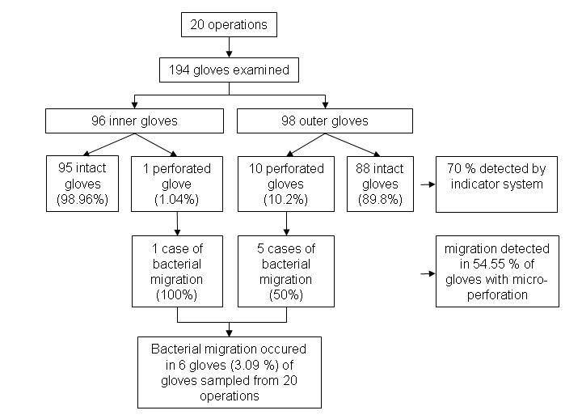
2010 Study on bacterial migration through gloves in surgery
Take Away:
About 10% of gloves evaluated had micro holes over a median time of 100 minutes.
About 3% of the gloves evaluated had bacterial migration through micro holes.
https://bmcinfectdis.biomedcentral.com/articles/10.1186/1471-2334-10-192

Slide 43
So, what does that mean for me?
Remember…
About 10% of gloves evaluated had micro holes over a median time of 100 minutes
About 3% of the gloves evaluated had bacterial migration through micro holes
And in our thought experiment we used…
672 gloves per month per person (21 working days)
So…
Potential for about 67 gloves to have micro holes per month (3x per day)
Potential for about 20 gloves to have bacterial migration (exposure to a pathogen) per month (1x per day)

Slide 44
How can we mitigate this risk?

Slide 45
PPE Usage
Employers are required to supply the right type in a sufficient quantity where potential exposures could happen.
Policy must include: type, location, use, removal, handling, and disposal

Slide 46
Personal Protective Equipment: Gloves
Utility Gloves
Sterile Gloves
Exam Gloves
Staff should wear gloves whenever there is potential for contact with blood, body fluids, mucous membranes, non-intact skin or contaminated equipment

Slide 47
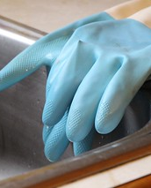
Utility glove considerations
Every employee potentially exposed to sharp instruments and chemicals during cleaning/ sterilization must have their own pair
Required when working with loose, contaminated instruments
Required when using surface disinfectants/ other cleaning chemicals according to chemical instructions
This Photo by Unknown Author is licensed under CC BY

Slide 48
Utility glove Usage
Store in operatory near transport container, hanging to stay dry
01
Don utility gloves after procedure, before tearing down operatory
02
Tear down operatory, including cleaning/ disinfecting surfaces
03
Transport instruments, in the transport container, wearing utility gloves to sterilization
04
Process instruments in sterilization area
05
Disinfect transport container, wash gloves, disinfect gloves
06
Carry all back to operatory to be stored for the next post-procedure process
07

Slide 49
Personal Protective Equipment: Mask and Eyewear
Masks
Eyewear
Consider ASTM Level
ANSI Z87.1
Staff should wear mouth, nose, and eye protection during procedures that are likely to generate splashes or spattering of blood or other body fluids
https://www.osha.gov/laws-regs/regulations/standardnumber/1910/1910.133

Slide 50
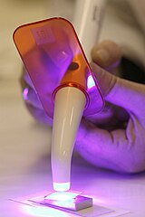
Other eye Safety considerations
Eyewash Stations
10 second walk from any hazard (55 feet)
Capable of:
15 minute flush
Tolerable temperature
Hands free activation in >1 second
Flush weekly and document
Annual Review and inspection
Blue Light Hazards
Protective eyewear required
Eye damage is cumulative
Types:
Orange tinted glasses
Orange tinted paddles
Anti-glare cone on curing light
https://www.ada.org/en/publications/ada-news/2016-
archive/april/ada-scientists- innovative- research-presented- at-aadr

Slide 51
Personal Protective Equipment: Protective Clothing
Cover Exposed Skin
Fluid Resistant
Staff should wear protective clothing that covers skin and personal clothing during procedures or activities where contact with blood, saliva, or OPIM is anticipated
https://www.osha.gov/laws-regs/regulations/standardnumber/1910/1910.1030

Slide 52
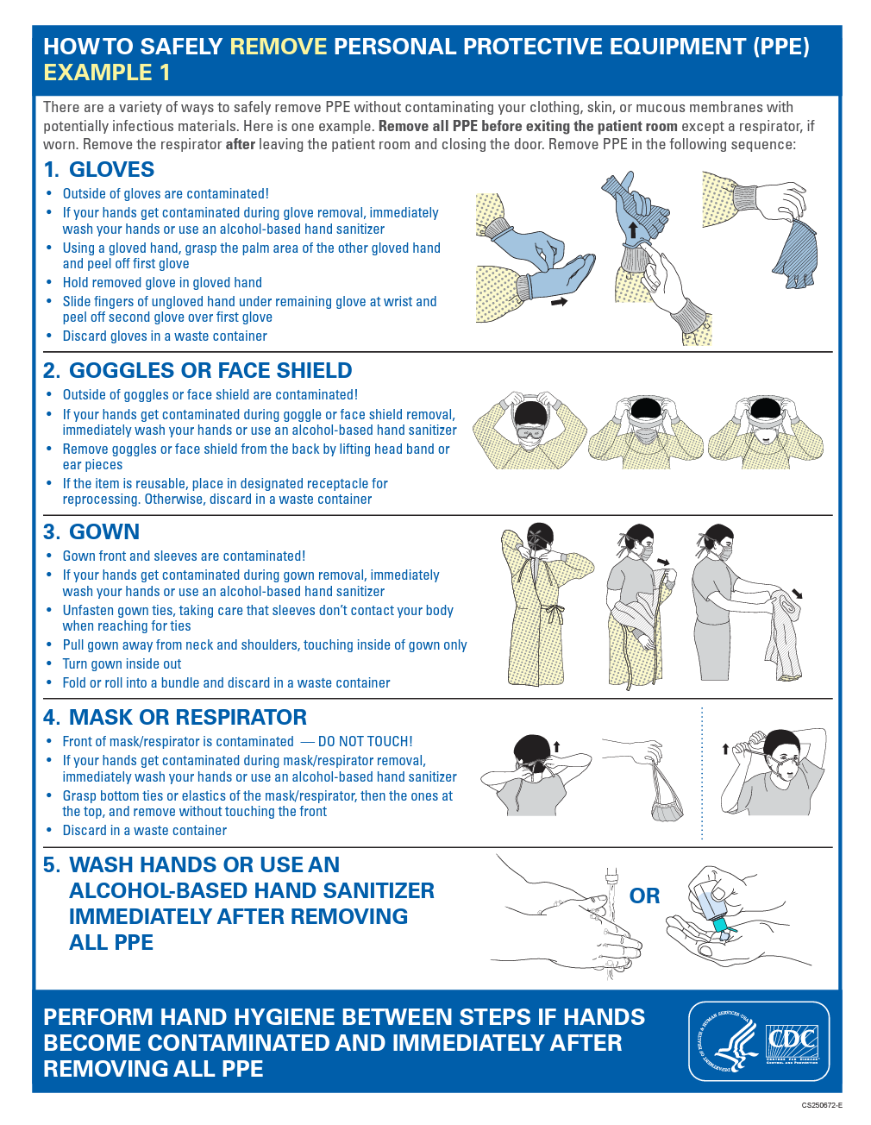
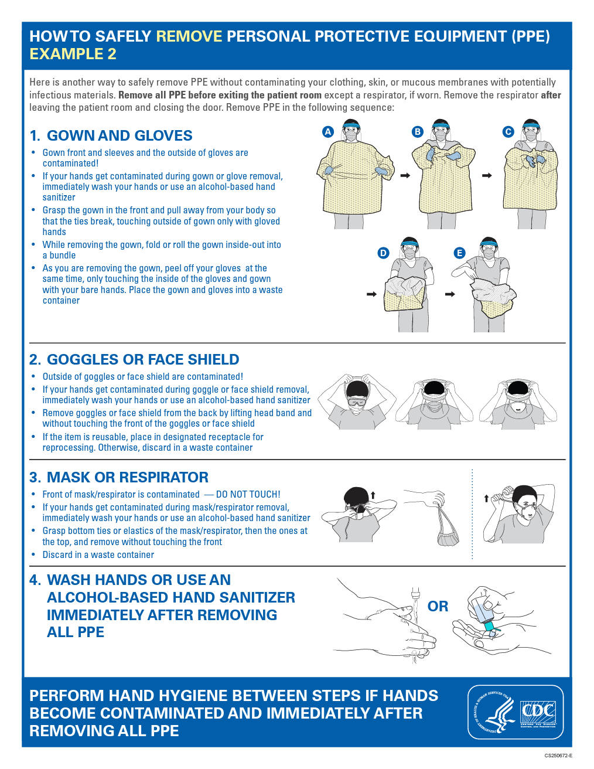
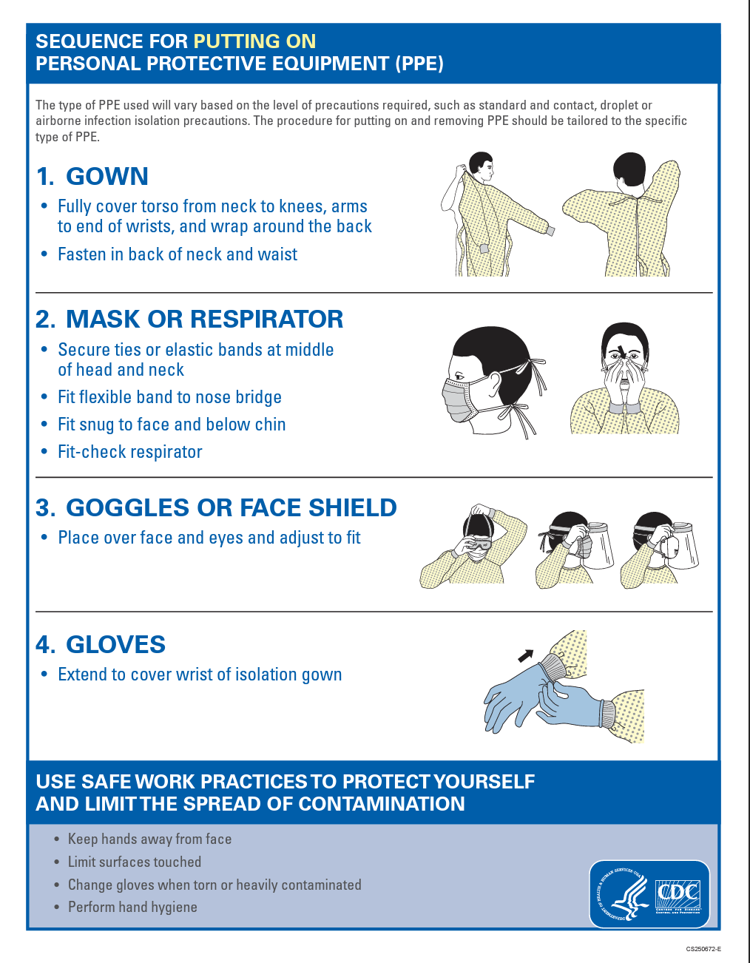
Personal Protective Equipment: Donning and Doffing
https://www.cdc.gov/hai/pdfs/ppe/ppe-sequence.pdf

Slide 53
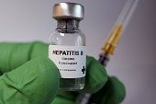
Hepatitis b vaccination
Must be offered to any staff that has reasonably anticipated contact with blood or OPIM unless they have documentation of a previous vaccination series, antibody testing has indicated immunity, or the vaccine is medically contraindicated
Offered at no cost to employee
Offered within 10 days of initial assignment as an employee
Employers must ensure employees are trained on efficacy, safety, method or administration and benefits of vaccination
Employees may decline but must sign a declination form that states the employee understands they remain at risk

Slide 54
Employers must help find Hep B records if able
If no documentation is found, you can repeat the Hep B series
Titer 1-2 months after series to determine immune status
If antibody +, no baseline testing is needed for patient and employee if an exposure happens
Vaccine non-responder
No antibodies after 2 completed Hep B series
Extra testing may be needed
No work restrictions

Slide 55
Post-exposure Evaluation and Follow-up
Exposure Incident
Employee Reports to Employer
Employer Directs Employee to Qualified Provider
Qualified Provider Evaluates Exposure Incident
Qualified Provider Sends Written Opinion to Employer
Employer Provides Written Opinion with Employee
ADA: Employer Obligations after Exposure Incidents

Slide 56
Internal reporting
Employees should report immediately
Allows for immediate medical evaluation and prophylaxis if necessary
Employer should review circumstances surrounding the event
Identify ways to prevent the circumstance from repeating
Documentation
Exposure Incident Report
Must be provided to Qualified Provider

Slide 57
Referral to qualified provider
Qualified Provider
Licensed HCP
Employer Responsibilities
Must Provide Follow-up at No Cost
Confidential Evaluation and Testing
Must Identify Source Patient if Able

Slide 58
Source patient Information
Document identity in writing on exposure incident report
Contact source patient and ask for consent to be tested for HBV and HIV
Results must be made available to exposed employee
Document, in writing, on exposure incident report
If source patient can not be identified
If source patient does not consent to testing
Unknown Exposure Protocol should be available

Slide 59
Qualified Provider Written Opinion
Employer
Must Provide to employee (15 days)
Qualified Provider
Must Provide Written Opinion
Written Opinion
Copy of BBP Standard
Job Description
Exposure Incident Report
Any Relevant Medical Records
Need for Further Follow-up
HBV Vaccination Information if Needed
Documentation Employee was Informed of Test Results

Slide 60
Post Exposure Follow-up
Remains confidential from employer
Qualified provider prescribes prophylaxis, treatment and counseling as need
Prophylaxis may need to be started immediately (1-2 hours after exposure)
Counseling
Test Results
Infectious Status
Prophylaxis and Treatment

Slide 61
BBP Training Requirements
Employee training must include:
Explanation of the exposure control plan and how to access it
Explanation of methods on how to recognize risk that may involve an exposure
Explanation of engineering and workplace controls
Explanation of PPE Usage
Information on Hepatitis B vaccination requirements
Information on exposure incident protocols
https://www.osha.gov/pls/oshaweb/owadisp.show_document?p_id=10051&p_table=STANDARDS

Slide 62
BBP Training Requirements
Employee training is required for initial hires and on an annual basis (at least every 365 days) for existing employees
Training must be at no cost to the employee and employer must pay the employee for their time
Training records must include employee designation (DDS, DH, DA), date and a description of the training
Training sessions must happen within 90 days of a policy change
https://www.osha.gov/pls/oshaweb/owadisp.show_document?p_id=10051&p_table=STANDARDS

Slide 63
Record keeping
Record job classifications within the office by employee title
Level I – routinely exposed
Level II – Occasionally exposed
Level III – never exposed
Training records
Maintain for 3 years at minimum
Best practice is to maintain for duration of employment
Employee medical records
Maintain for 30 years after employment
https://www.osha.gov/pls/oshaweb/owadisp.show_document?p_id=10051&p_table=STANDARDS

Slide 64
OSHA Hazard communications Standard
Standard 1910.1200

Slide 65
How HCS works

Slide 66
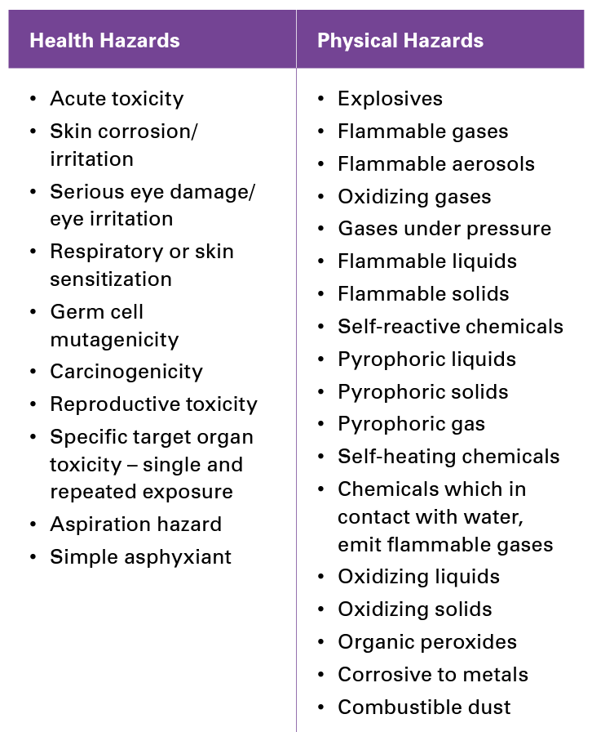
What is a hazardous Chemical?
Any chemical that is classified as a health or physical hazard

Slide 68
6 steps to Creating an effective HCS Program

Slide 69
Creating an effective HCS Program

Slide 70
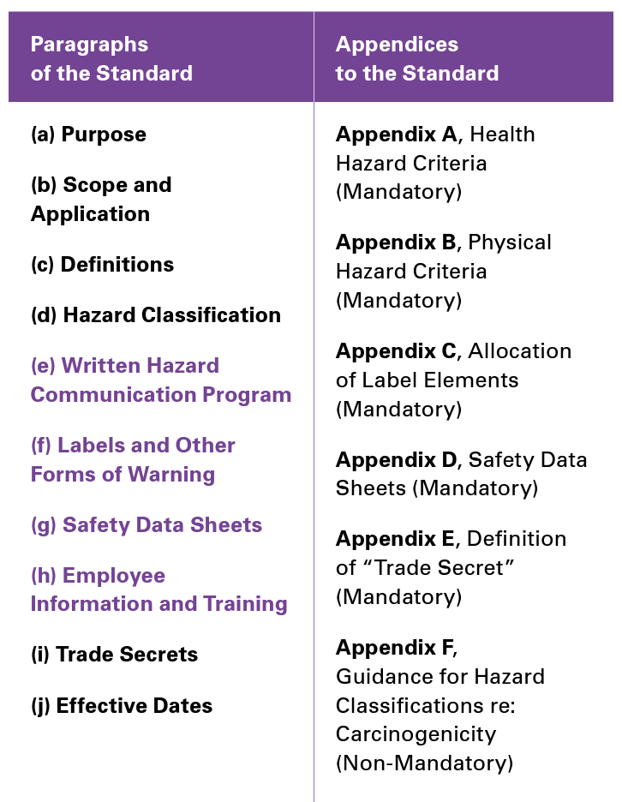
Organization of the Regulatory requirements for the hcs

Slide 71
Creating an effective HCS Program

Slide 72
What policies are required?
Labels and Forms of Warning
Safety Data Sheets
Employee Information and Training
Including informing employees of hazards of non-routine tasks

Slide 73
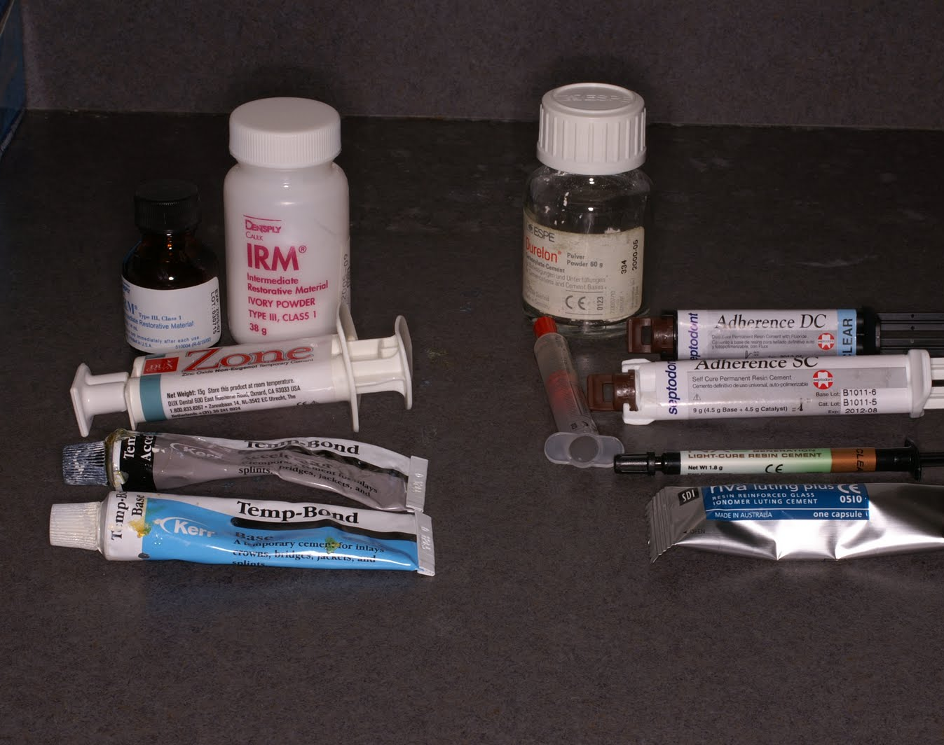
Chemical Inventory List
A comprehensive list of potentially hazardous chemicals found in the practice for which SDS sheets are required
Organized by product identifier (can match SDS sheets)
Helps manage inventory and SDS sheets
Think outside the box when identifying chemicals
This Photo by Unknown Author is licensed under CC BY-NC-ND

Slide 74
Creating an effective HCS Program
Labels communicate the hazard associated with a certain chemical
Labels must be on every container (manufacturer or secondary) that is being used
If a product is transferred to a secondary container for immediate use, it does not need a label

Slide 75
Label requirements
Product Identifier: Chemical, Common or Trade Name
Signal Word: Level of Severity
Danger, Warning
Hazard Statement: Describes the Nature of the Hazard
Harmful if Swallowed
Pictogram: Symbol for Specific Hazard Information
Precautionary Statement: Preventative Measures for Product
Do not eat drink or smoke while using this product

Slide 76
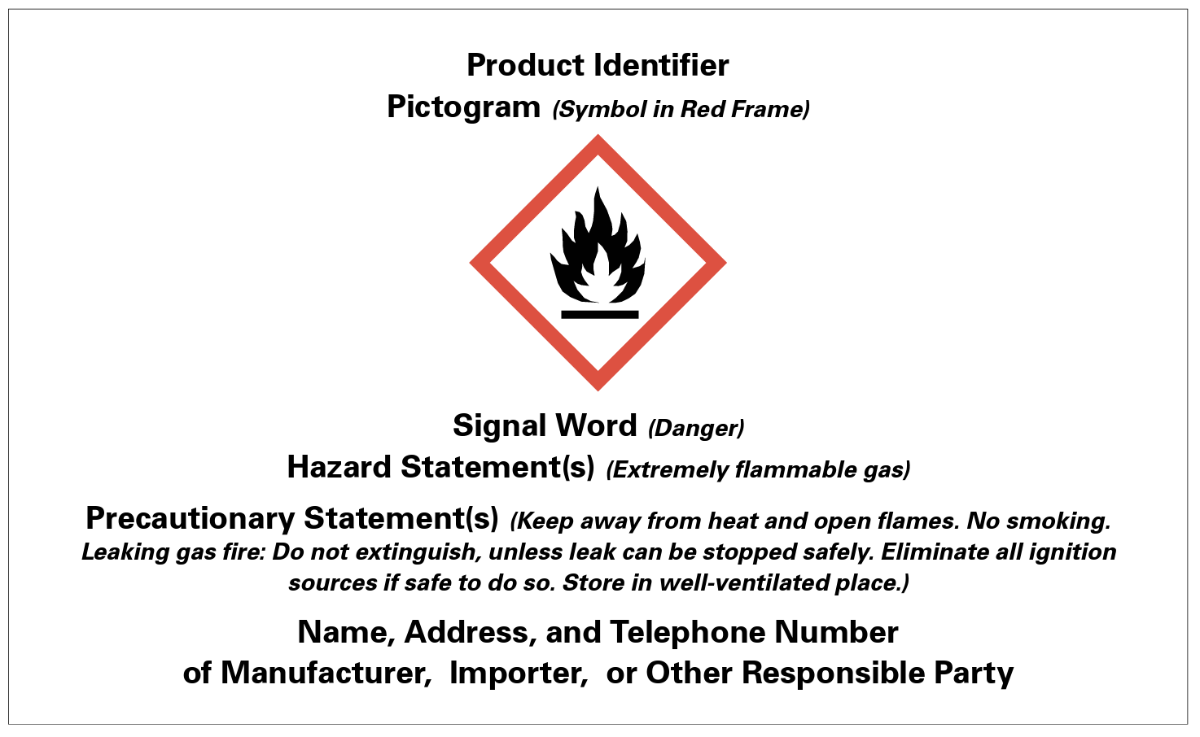
Manufacturer Label requirements

Slide 77
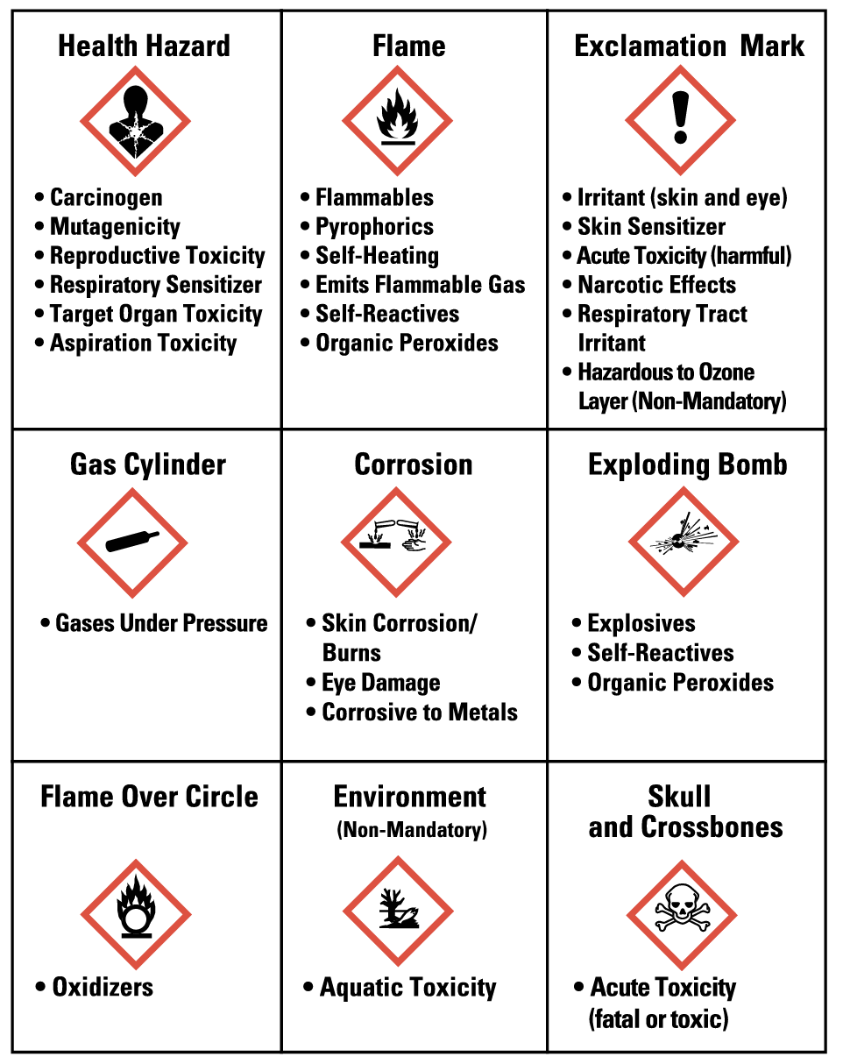
Pictograms

Slide 78
Label plan requirements
Designation of responsibility for ensuring compliant labeling of all containers
Appropriate labels on all workplace containers, both shipped and secondary
Description and explanation of labels on both shipped and secondary containers included in the employee training program
Procedures to review and update workplace label information when necessary

Slide 79
Creating an effective HCS Program
Detailed information on hazardous chemicals
Internationally standardized 16-section format

Slide 80
SDS requirements
Designation of responsibility for obtaining and maintaining the SDSs
How sheets are maintained and how employees can access them during work tasks
Procedures on what to do when the SDS sheet is not received with the product
SDS for each hazardous chemical in the facility
Staff training on review of SDS format and how to use them

Slide 81
Things to think about
The most up to date SDS must be obtained for all chemicals
SDS sheets must be provided in English
SDS sheets must be readily available to all staff in their work areas
If SDS are kept electronically, there must be a back up if the electronic version is not available
SDS sheets should be used to determine protective measures for each chemical used

Slide 82
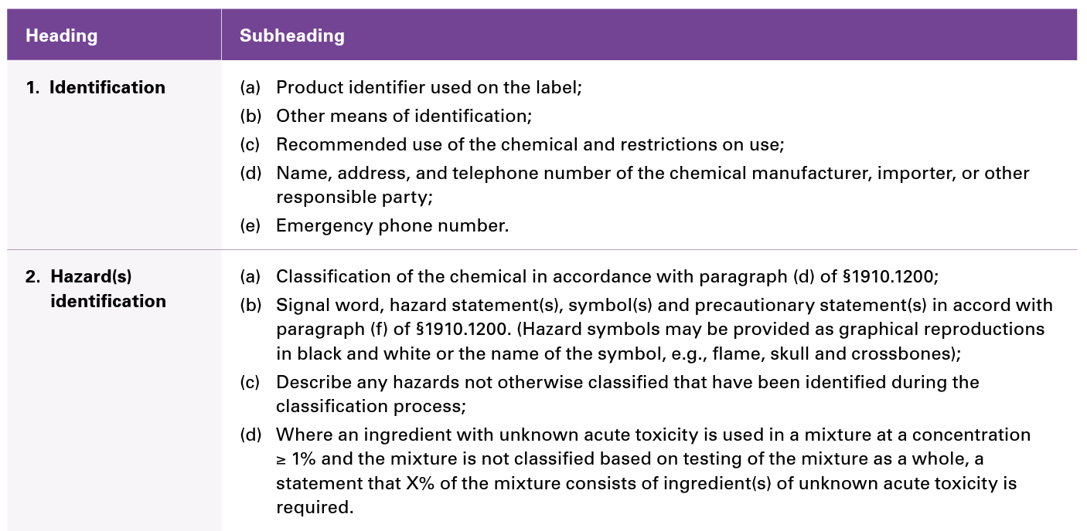
Minimum Information for SDS

Slide 83
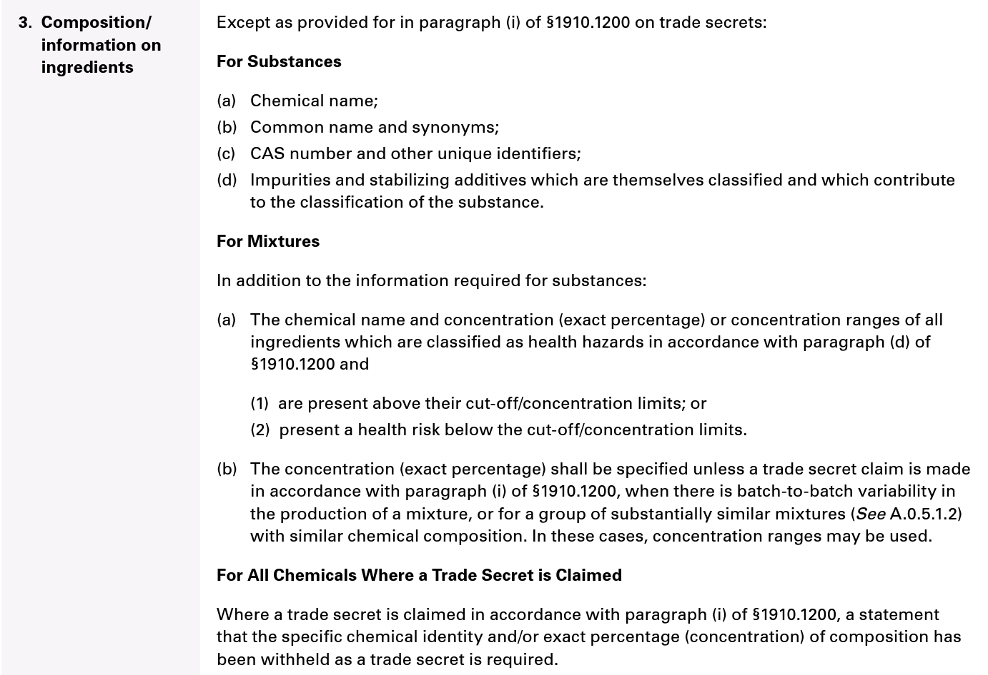
Minimum Information for SDS

Slide 84
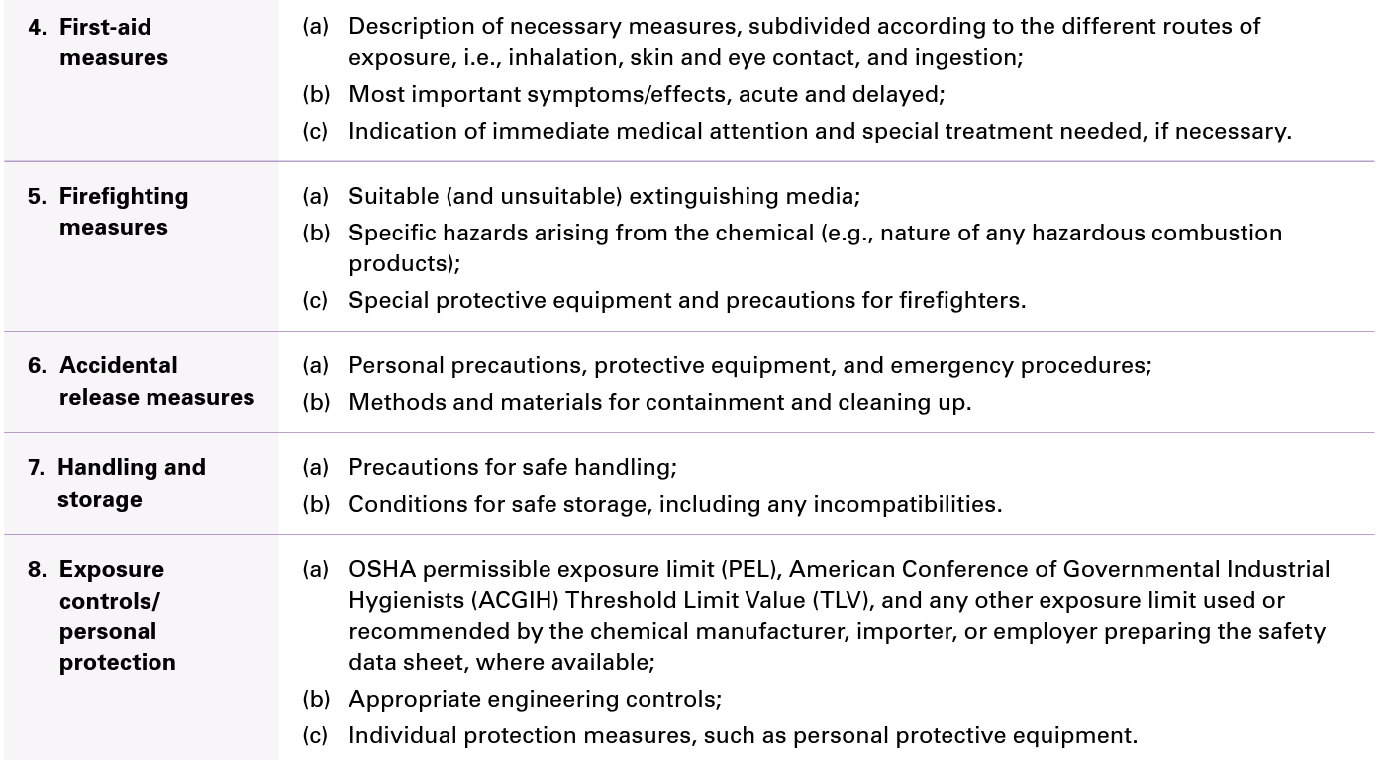
Minimum Information for SDS

Slide 85
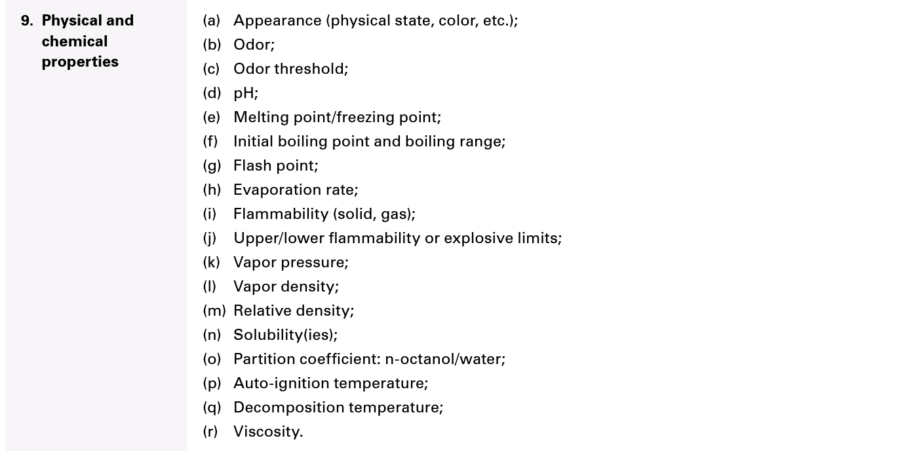
Minimum Information for SDS

Slide 86
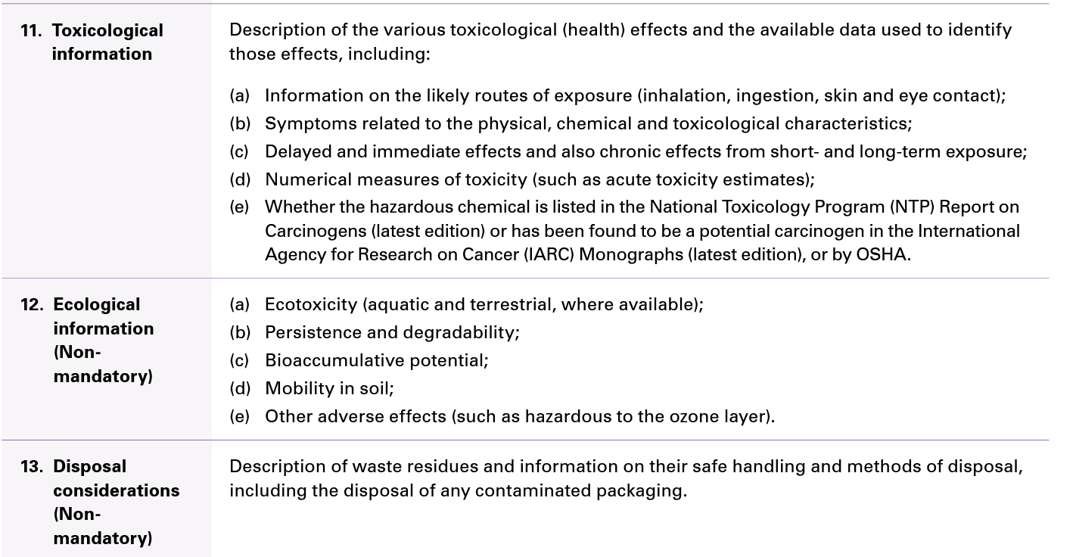
Minimum Information for SDS

Slide 87
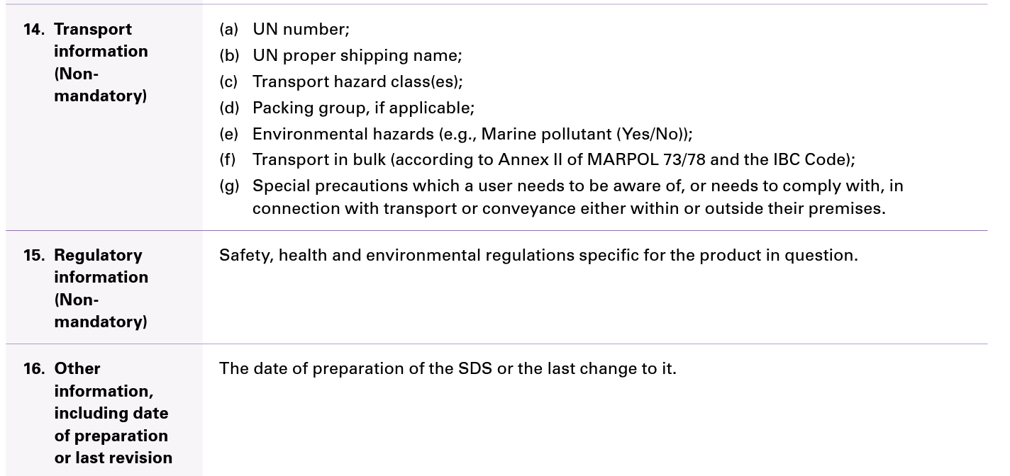
Minimum Information for SDS

Slide 88
How long do you have to keep sds?
SDS are considered a part of employee exposure records and must be maintained for 30 years
Maintain SDS on all chemicals in current and historical use
Maintain record that identifies the substance used, where and when it was used
Current Use Binder
Archive Binder
Archive Binder can be translated into a log record of the chemical with dates of use
https://www.osha.gov/laws-regs/standardinterpretations/1987-10-01#:~:text=OSHA%20standard%2C%2029%20CFR%201910.1020,for%20at%20least%2030%20years.

Slide 89
Creating an effective HCS Program

Slide 90
Training and education
Upon hire, annually and when things change
Where hazardous chemicals are located
Where and how employees can access the program and details of the program
Methods of detecting the presence of a hazardous chemical spill
Measures employees can take to protect themselves

Slide 91
Training and education cycle
Determine if and when training is needed
1
Identify training needs
2
Identify goals and objectives
3
Identify learning activities
4
Conduct the training
5
Evaluate and improve the training
6

Slide 92
Creating an effective HCS Program

Slide 93
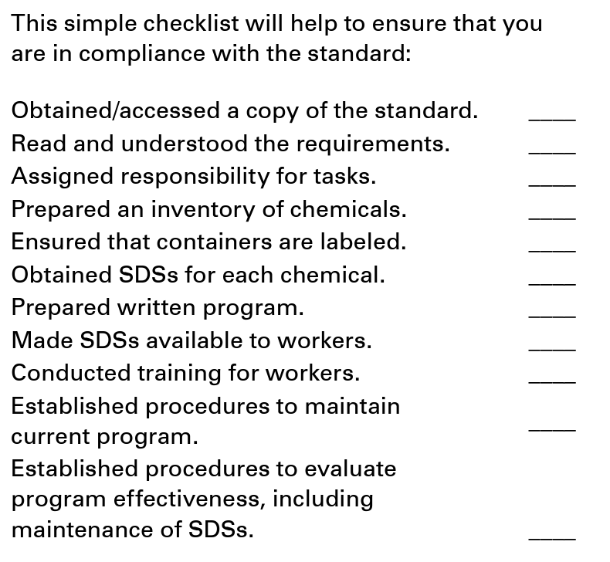
Hazard Communication Standard Compliance Checklist

Slide 94
Break time

Slide 95
OSHA Respiratory protection standard
Standard 1910.134

Slide 96
Why is respiratory protection important in dentistry?

Slide 97
Aerosols vs. Droplets
Aerosols: Tiny particles that can survive on air currents and travel large distances to reach a susceptible person
Aerosols are created when a patient coughs, talks, sneezes or during a procedure that produces aerosols
COVID-19, chickenpox, measles, TB
Droplets: Sprays or splashes that generally travel a short distance (6 feet or less) before reaching a susceptible person
Droplets are created when a person coughs, sneezes or during a procedure that creates spray or splatter
RSV, influenza
https://www.cdc.gov/infectioncontrol/spread/index.html
Notes:
Facilitator Notes:
Review the concept that aerosols are different that droplets in healthcare.
Sample Script:
Let’s talk about the differences between aerosols and droplets. First is the size. Aerosols are approximately 5 micrometers or smaller in size and can remain in the environment for long periods of time. Droplets are approximately 10 micrometers or larger and travel short distances.
Both aerosols and droplets are created and spread when a patient coughs, talks, sneezes, or during dental procedures that create aerosols, droplets, spray, or splatter. Illnesses such as COVID-19, chickenpox, measles, tuberculosis, RSV, and influenza can spread through the air or through contact with infected respiratory secretions and saliva.
References
Precautions | Appendix A | Isolation Precautions | Guidelines Library | Infection Control | CDC
Precautions, Bloodborne, Contact, and Droplet - StatPearls - NCBI Bookshelf (nih.gov)
PowerPoint Presentation (nationalacademies.org)
Measles - Medical Information | Occupational Safety and Health Administration (osha.gov)

Slide 98
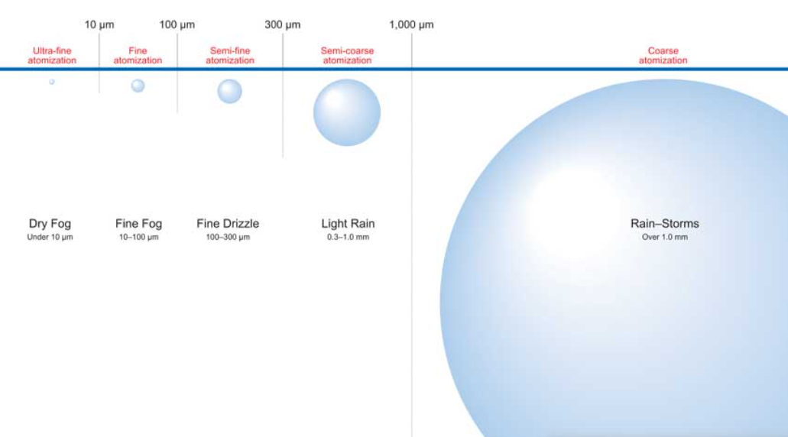
https://www.ikeuchi.eu/news/measurement-of-droplet-size/

Slide 99
Aerosols vs. Droplets
6 feet
12 feet
18 feet
Notes:
Facilitator Notes:
Visual on the difference of droplets and aerosols.
Sample Script:
Now that we have a better idea of the size differences between aerosols and droplets, let us look at how far the particles can potentially travel. Again, the distances are approximations and can vary based on several factors, such as air temperature and current, and the size, shape and density of the aerosol and droplet particle.
As we can see, droplets are larger and heavier than aerosols and fall to the ground in seconds. In contrast, the travel distance of aerosol particle is greater and can stay airborne for minutes, hours, or days.
References
PowerPoint Presentation (nationalacademies.org)
How Infections Spread | Infection Control | CDC

Slide 100
Why is dentistry different?
Many dental operative and preventative procedures require the use of equipment that produce aerosols and droplets.
Notes:
Facilitator Notes:
Unlike other healthcare settings, a lot of procedures in dentistry create droplets and aerosols.
Procedures in both preventative and operative areas are known to create aerosols.
Sample Script:
Unlike other healthcare settings, many dental preventative and operative procedures create droplets and aerosols.\
What procedures do you think would produce aerosols and droplets?

Slide 101
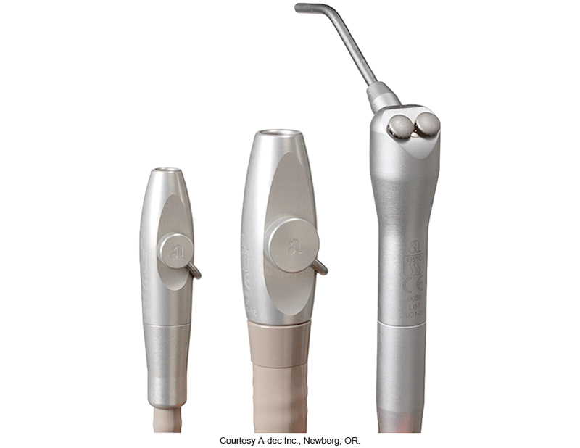
Aerosol Generating Procedures (AGP): Operative
Commonly used equipment known to create aerosols in operative procedures include high-speed dental handpieces and air/water syringes
https://www.cdc.gov/coronavirus/2019-ncov/hcp/infection-control-recommendations.html
Notes:
Facilitator Notes:
There isn’t a list of procedures that are considered aerosol generating.
Instead, the CDC defines AGPs using common equipment in dentistry that is known to produce aerosols.
Operative equipment that is known to generate aerosols are handpieces and air/ water syringes.
Sample Script
Let us turn our attention to elements or actions that create aerosols during dental operative procedures. The CDC does not provide a list of aerosol-generating procedures, or AGPs, for dental operative procedures; however, the CDC identifies AGPs associated with commonly used dental equipment known to create aerosols, such as high-speed dental handpieces, and air/water syringes.
References
Infection Control: Severe acute respiratory syndrome coronavirus 2 (SARS-CoV-2) | CDC
Infection Prevention and Control Practices of Dental Hygienists in the United States During the COVID-19 Pandemic: A longitudinal study | Journal of Dental Hygiene (adha.org)

Slide 102
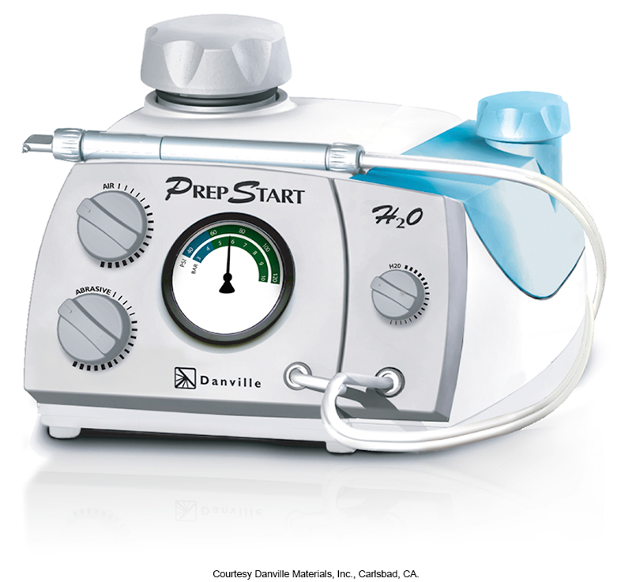
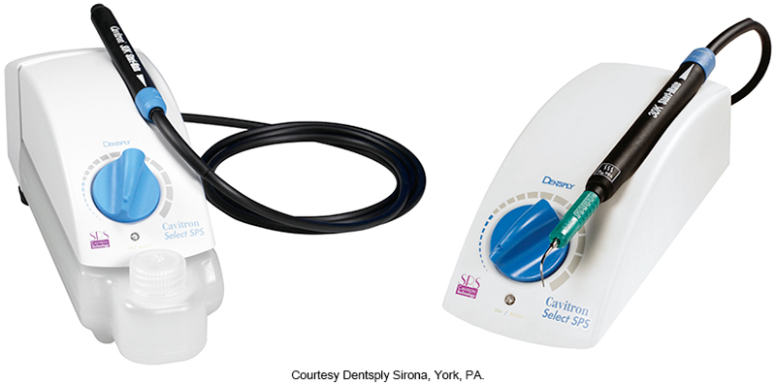
Aerosol Generating Procedures (AGP): Preventative
Commonly used equipment known to create aerosols in preventative procedures include ultrasonic scalers, air polishers, and air abrasion machines
https://www.cdc.gov/coronavirus/2019-ncov/hcp/infection-control-recommendations.html
Notes:
Facilitator Notes:
Preventative procedures use specialized equipment that is different than operative equipment
Ultrasonic scalers, air polishers and air abrasion machines are equipment that are known to generate aerosols.
Sample Script
Like dental operative procedures, the CDC does not provide a list of AGPs for dental preventative procedures; however, the CDC identifies AGPs for commonly used dental equipment known to create aerosols during preventive procedures such as ultrasonic scalers, air polishers, and air abrasion machines.
References
Infection Control: Severe acute respiratory syndrome coronavirus 2 (SARS-CoV-2) | CDC
Infection Prevention and Control Practices of Dental Hygienists in the United States During the COVID-19 Pandemic: A longitudinal study | Journal of Dental Hygiene (adha.org)

Slide 103
What’s required?

Slide 104
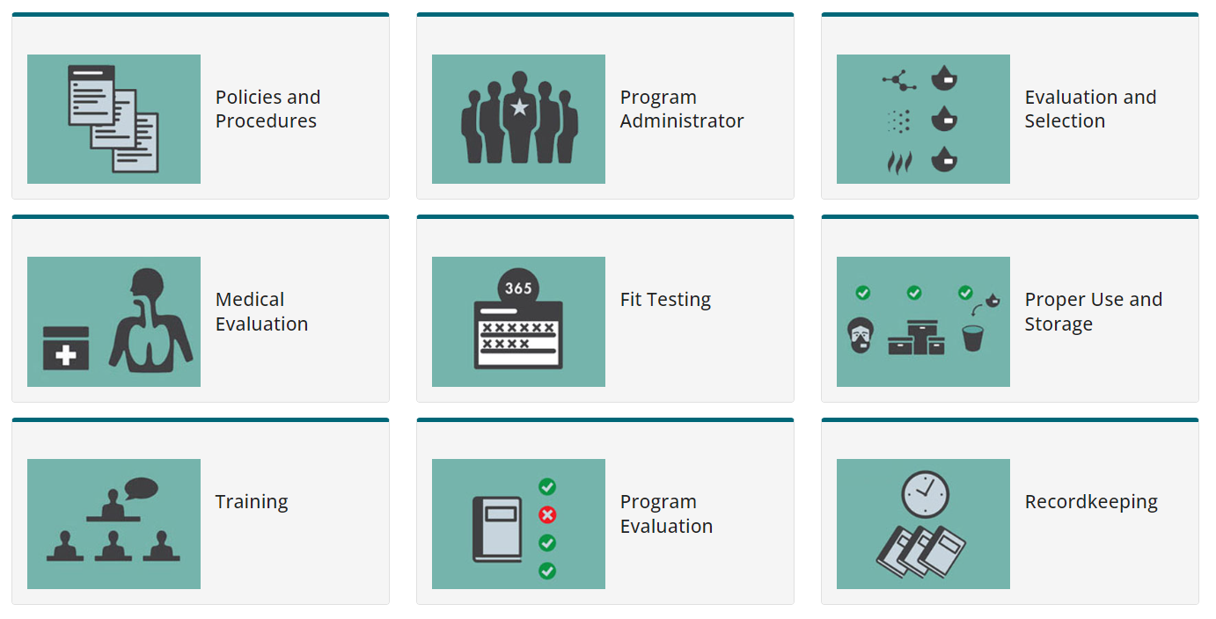
OSHA Respiratory Protection program
https://www.cdc.gov/niosh/npptl/hospresptoolkit/default.html

Slide 106
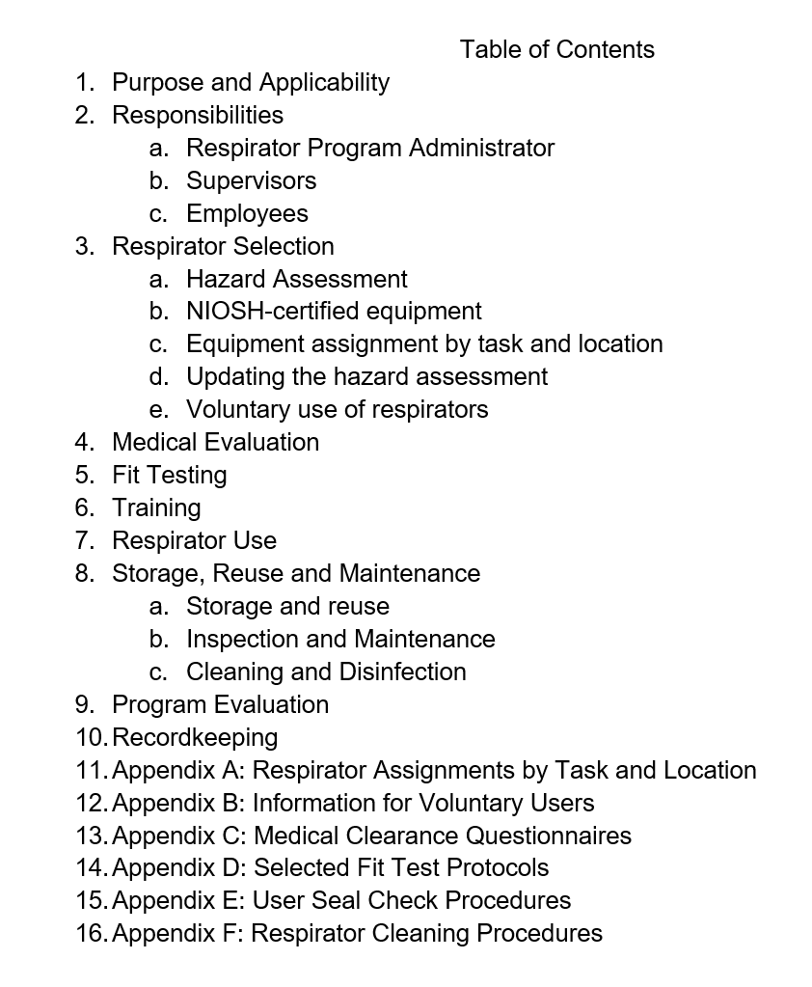
Respiratory Protection Program
Employers must develop a Written Respiratory Protection Program (OSHA Policy)

Slide 107
Respirator Program administrator
Help conduct Hazard Assessment
Develop and monitor respirator maintenance procedures
Coordinate purchase, maintenance, repair and replacement of respirators
Arrange for initial annual training
Ensure that medical evaluations are completed
Ensure initial and annual fit testing is completed
Maintain records of training, medical evaluations and fit testing
Maintain and review the RPP

Slide 108
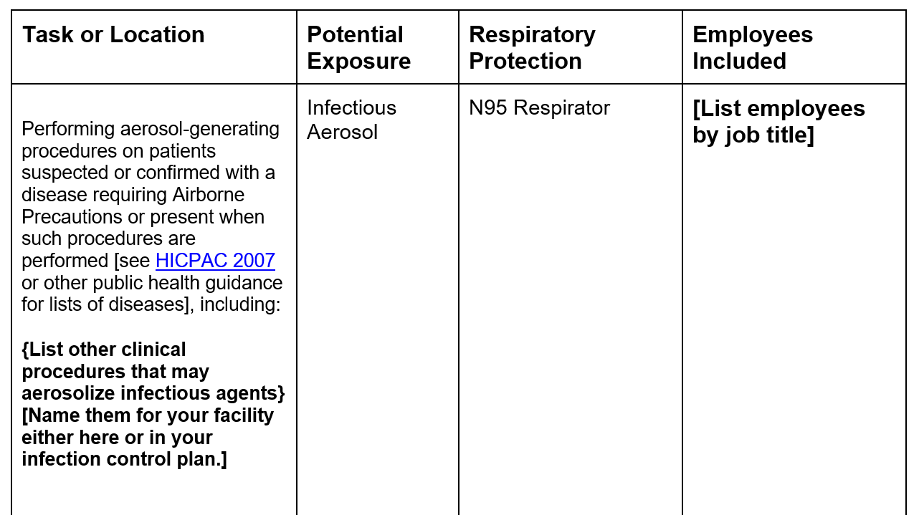
Hazard Assessment
Hazard (Risk) assessment must:
Identify potential hazards
Determine potential exposure risk levels for all tasks performed for all staff
the employer can always choose to select a higher level of respiratory protection than the minimum

Slide 109
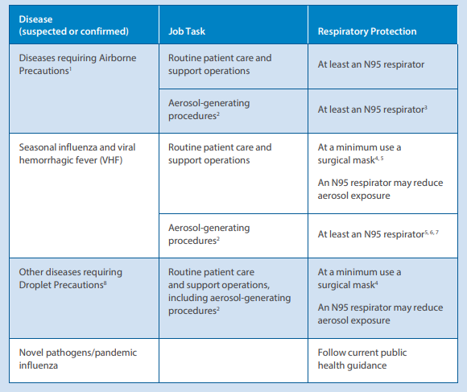
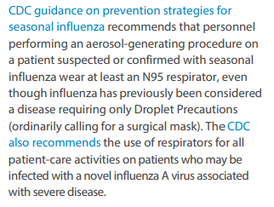

Slide 110
Respirator selection
Filtering Facepiece Respirators
Elastomeric Half Face Respirators
Elastomeric Full-Face Respirators
Powered Air Purifying Respirators
https://www.cdc.gov/coronavirus/2019-ncov/hcp/elastomeric-respirators-strategy/respiratory-protection.html

Slide 111
https://www.cdc.gov/niosh/docs/video/2023-120/

Slide 112
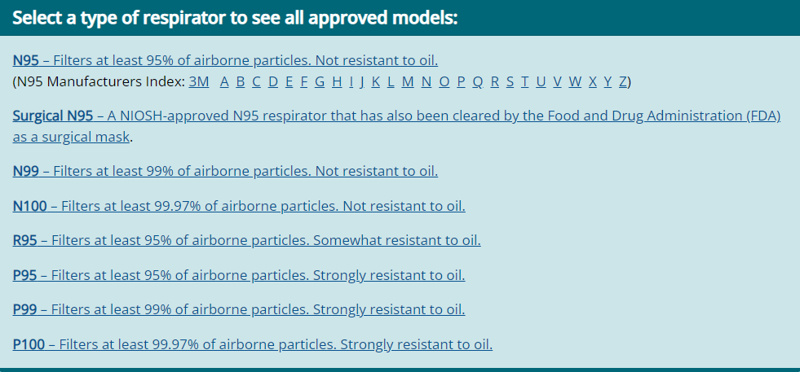
https://www.cdc.gov/niosh/npptl/topics/respirators/disp_part/default.html

Slide 113
What is niosh?

Slide 114
Respirator Use Policies
Inspection
Donning
User Seal Check
Doffing
Recognition of Failure
Facial Hair

Slide 115
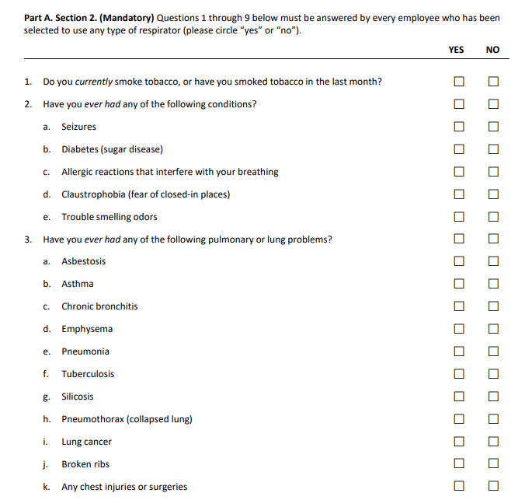
Medical Evaluation
Medical clearance must happen prior to assigning any employees to work in an area where respirators are required
Medical questionnaire must be filled out by every employee that is assigned to work in an area where a respirator is required
Medical evaluations must be performed by a physician

Slide 116
Medical evaluation considerations
Employer or supervisor can not see the completed medical evaluation
No requirement on reevaluation schedule
Based on evaluation answers, a more in depth exam may be needed
Develop a policy on what will be done if an employee is not cleared for respirator use

Slide 117
Medical evaluation option for small practices: 3M Online respirator medical evaluation
https://www.3m.com/3M/en_US/respiratory-protection-us/support/center-for-respiratory-protection/medical-evaluation/osha-respirator-questionnaire/online-evaluations/

Slide 118
Initial Fit Testing
Employees must have a completed medical evaluation before they can be Fit Tested
Employees must have initial fit testing done on the specific model of respirator used before they are allowed to work in it
Fit testing can be performed by anyone that is trained to do it
Third party organizations
Trained employee (kits can be purchased to do this in office)
Supply rep
Local health department
Local hospital organization

Slide 119
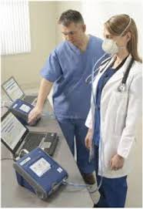
Types of Fit Testing
Quantitative:
Utilizes a machine
that either creates an
aerosol within a chamber
and measures the volume
respired or measures the
volume of condensation in the respirator to evaluate fit
Outputs an Overall Fit Factor (OFF) value to determine the fit of the respirator
Qualitative:
Utilizes a chemical to measure the fit of a respirator
Employee wears a hood and is asked if they can smell or taste the chemical
The test is performed without a respirator to determine a threshold level and then with a respirator to determine the fit and seal of the respirator
https://www.osha.gov/laws-regs/regulations/standardnumber/1910/1910.134AppA

Slide 120
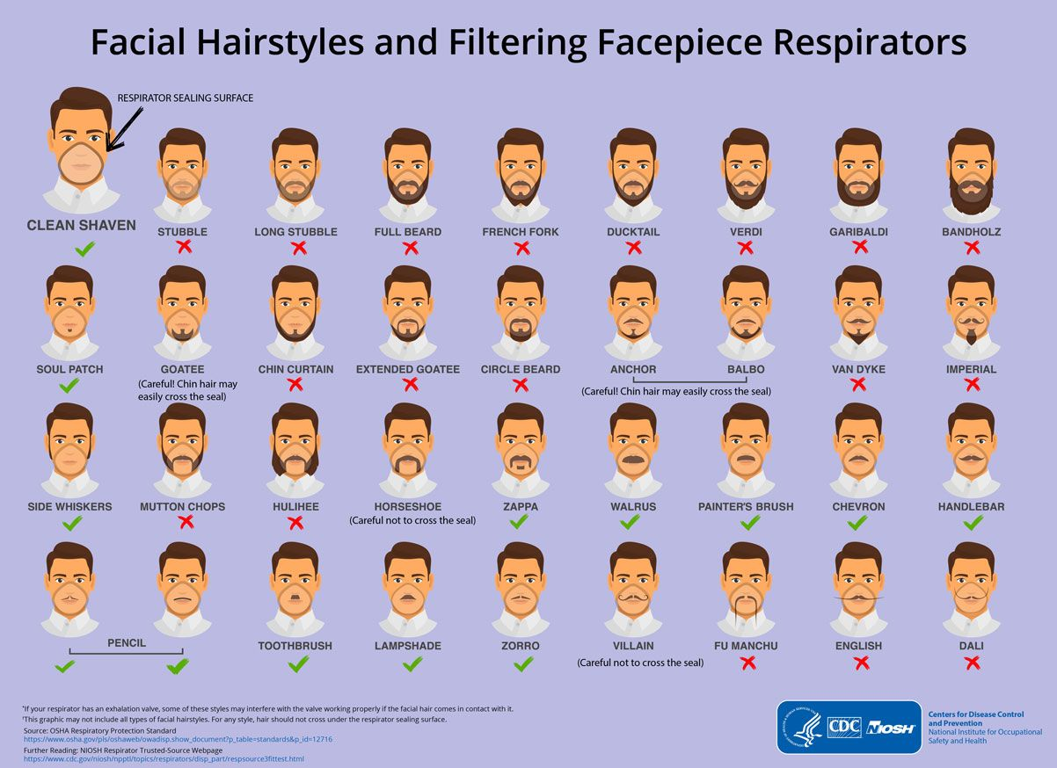
https://blogs.cdc.gov/niosh-science-blog/2017/11/02/noshave/

Slide 121
Additional Fit Testing considerations
Fit testing should be completed on an annual basis after the initial fit test
Fit testing should also be completed anytime the respirator brand or model changes
Individual fit testing should be done if there is a change in the employee's facial structure, facial hair, etc.

Slide 122
Training
Training must be provided on initial respirator assignment and on an annual basis
Training should include:
Respirator Selection
Proper Donning
User Seal Check
Proper Doffing
Proper Disposal

Slide 123
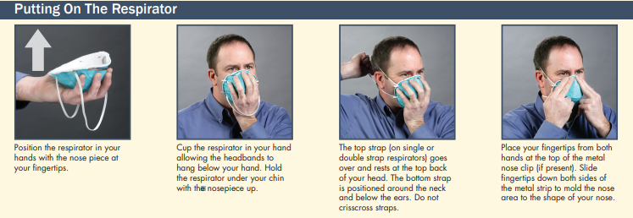
Donning a respirator

Slide 124
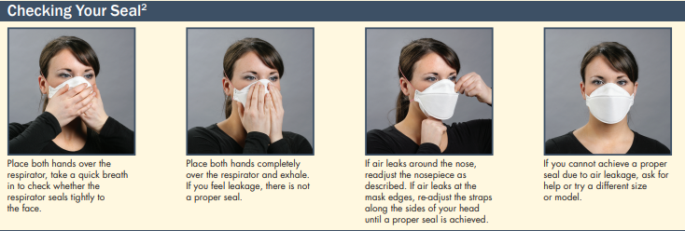
User Seal check

Slide 125
Doffing respirator

Slide 126
Record keeping
Recordkeeping should include
Employee Medical Records
Documentation Of All Trainings
Documentation of evaluation and revisions of RPP

Slide 127
Program Evaluation
A periodic evaluation of the RPP is required and must be conducted (at least annually)
There are no standards regarding how you evaluate, if it is a comprehensive review
This could include:
A comprehensive review of the written program
A program evaluation checklist based on observations of workplace practices
Review of feedback from employees collected during training
Any revisions brought about by the evaluation should be documented
Any procedural changes brought about by the review should be communicated to employees

Slide 128
High risk areas in dentistry

Slide 129
Are these high risk areas included in osha requirements?

Slide 130
Environmental Cleaning and Disinfection
This Photo by Unknown Author is licensed under CC BY

Slide 131
Surface Disinfectants
EPA Registration
List B: EPA Registered Tuberculocide Products Effective Against Mycobacterium tuberculosis
List E: EPA’s Registered Antimicrobial Products Effective Against Mycobacterium tuberculosis Human HIV-1 and Hepatitis B Virus
List N: Disinfectants for Use Against SARS-CoV-2
Surface disinfection is 2 steps
Clean
Disinfect
New wipe for each surface
Move away from the use of spray
Follow instructions for wet/ contact time and safety measures

Slide 132
Disinfectant​ | Uses​ | Advantages​ | Disadvantages​
Alcohols​ | Skin antiseptic, surface disinfectant​ | Bactericidal, tuberculocidal, fungicidal, virucidal; Fast acting, no residue, no staining, good for small surfaces like rubber vial stoppers​ | No sporicidal, volatile, evaporation diminishes concentration, no detergent or cleaning properties, not EPA registered, may harden rubber or cause glue deteriorization​
Chlorine​ | Disinfect surfaces after blood spills, surface cleaning, water treatment​ | Bactericidal, tuberculocidal, fungicidal, virucidal, low cost, fast acting, readily available in non-hospital settings, EPA registered​ | Corrosive, inactivated by organic material, irritant to skin and mucous membranes, shelf live shortens when diluted, release of toxic chlorine gas when mixed with acid or ammonia​
Improved hydrogen peroxide​ | Disinfect surfaces​ | Bactericidal, virucidal, tuberculocidal, some newer preparations are sporicidal, safe for workers, fast acting, breaks down into water and oxygen, unaffected by organic matter, non-staining, EPA registered​ | More expensive than some low- level disinfectants; strong vapor profile (vinegar odor)​
Phenolics​ | Cleaning hard surfaces that don't touch mucous membranes, ​ | Bactericidal, tuberculocidal, fungicidal, virucidal, Leaves a residual film, commercially available with added detergents to provide 1 step cleaning and disinfecting​ | Not sporicidal, not for use in nurseries, not for use on food contact surfaces; may be absorbed through skin or rubber​
Quaternary ammonium compounds​ | Clean floors, walls, and furnishings. Clean blood spills​ | Bactericidal, fungicidal, virucidal against enveloped viruses, usually have detergent properties, generally not irritating to hands​ | Not sporicidal, generally not tuberculocidal, and virucidal against nonenveloped viruses; not for use on instruments, narrow microbiocidal spectrum​

Slide 133
The process

Slide 134
Microbial Persistence on Dry Surfaces*
Microorganism | Duration of Persistence
SARS-CoV-2 (Most common route is aerosol transmission) | 2-3 days (plastics/ SS surfaces) 24 hours (cardboard)
Staphylococcus aureus, including MRSA | 7 days – 7+ months
Enterococcus sp., including VRE | 5 days – 4 months
Escherichia coli | 1.5 hours – months
Noroviruses | 8 hours – 2 weeks
Influenza viruses | 1-2 days
Rhinoviruses | 2 – 24 hours
Herpes Simplex Viruses (HSV) | 4 hours – 8 weeks
Hepatitis B Virus (HBV) | >1 week (in blood)
Hepatitis C Virus (HCV) | 16 hours – 6 weeks (in blood)
Hepatitis A Virus (HAV) | 2 hours – 2 months
Human Immunodeficiency Virus (HIV) | A few hours – a few days (in the right conditions)
*Microbial persistence depends on a very specific set of conditions outside of the body. Temperature and bioburden can affect persistence.

Slide 135
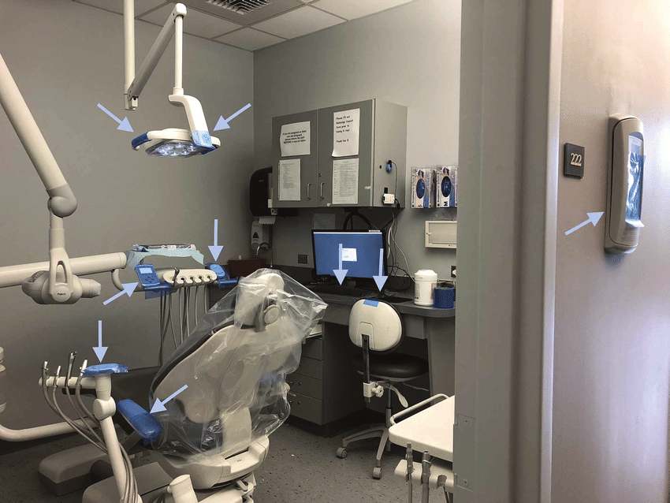
Barriers
Covers hard to clean areas
Must be fluid resistant
Must be disposable
Must be changed between each patient
Should you clean/ disinfect under barriers?

Slide 136
Instrument Cycle (Sterilization)
Intake
Preclean
Package
Sterilize
Inspect
Inspect
Patient Use
Store
https://www.cdc.gov/oralhealth/infectioncontrol/pdf/.pdf

Slide 137
Intake
Point of use disposal
Garbage
Sharps
Transport (OSHA Requirement)
Puncture and leak proof
Latchable/ lockable
https://www.cdc.gov/oralhealth/infectioncontrol/pdf/.pdf

Slide 138
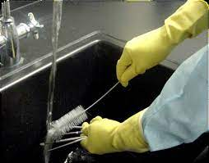
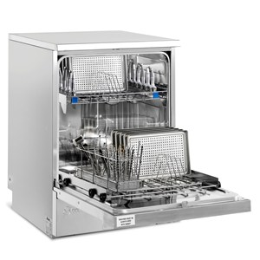
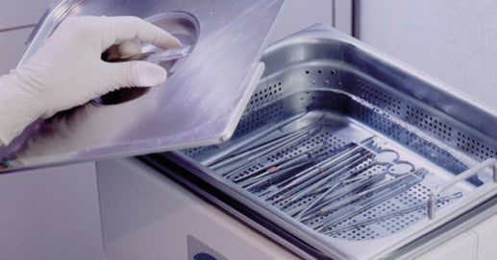
Preclean
Pre-soak
Hand Scrubbing
Automated
Instrument washer/ disinfector
Ultrasonic cleaner
https://www.cdc.gov/oralhealth/infectioncontrol/pdf/.pdf

Slide 139
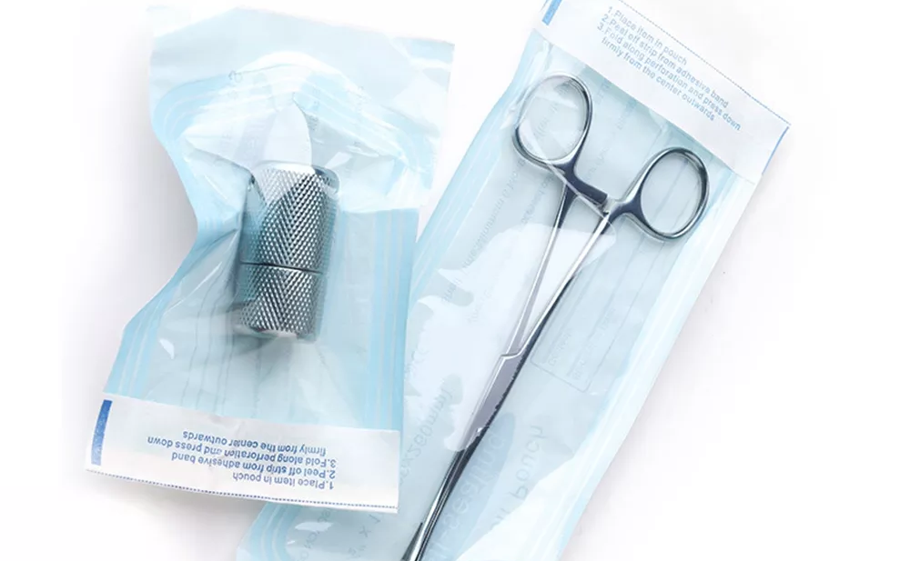
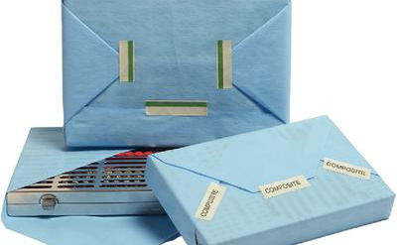
Packaging
Dry instruments
Labeling
https://www.cdc.gov/oralhealth/infectioncontrol/pdf/.pdf

Slide 140
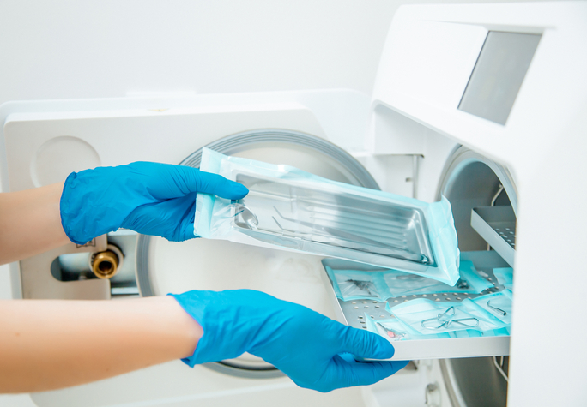
Sterilize
Paper up or paper down?
Handpieces?
Sterilizer maintenance
Record keeping
https://www.cdc.gov/oralhealth/infectioncontrol/pdf/.pdf

Slide 141
Dental Handpieces
https://www.cdc.gov/oralhealth/infectioncontrol/statement-on-reprocessing-dental-handpieces.htm

Slide 142
Example of HP sterilization cycles
https://www.ultimatedental.com/uploads/KaVoHandpieceMaintenanceGuide.pdf

Slide 143
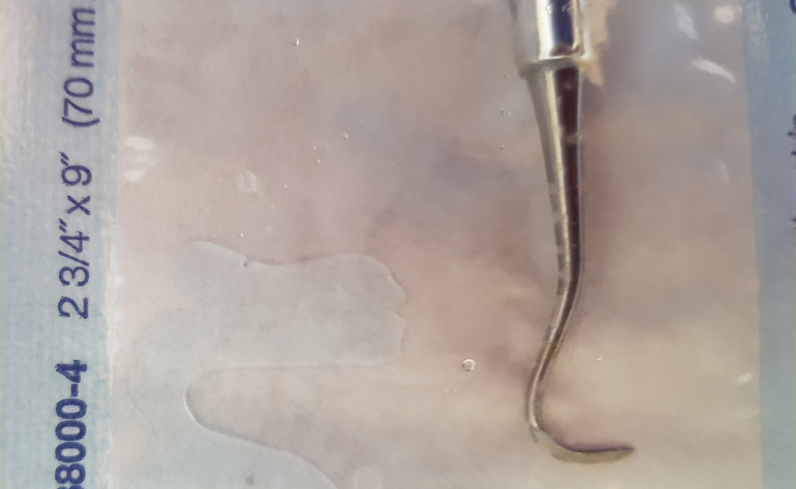
Inspection and Storage
Inspection?
Wet packs?
Store in closed dry area
https://www.cdc.gov/oralhealth/infectioncontrol/pdf/.pdf

Slide 144
Inspection and Use
What to look for?
Damaged packs
Not sterile/ processed
Opening and use
https://www.cdc.gov/oralhealth/infectioncontrol/pdf/.pdf

Slide 145
Indicators and Integrators
Indicator (Type 1)
Integrator (Type 5)
Single Parameter (temp)
Multi Parameter (time, temp, pressure)
Internal and External in every cassette/ pouch
At least 1 in every load
Process Challenge
https://www.cdc.gov/oralhealth/infectioncontrol/pdf/.pdf

Slide 146
Biological Monitoring
Biological Monitoring
Lab test confirming spores are destroyed
Testing each sterilizer at least weekly
In-house and mail-in tests
https://www.cdc.gov/oralhealth/infectioncontrol/pdf/.pdf

Slide 147
Dental Burs
Hard to clean because of the nature of the cutting end of the bur
Many are single use/ disposable, check the manufacturer’s instructions for use (IFU) before reuse
Only reprocess according to manufacturer’s instructions for use (IFU)
If there are no reprocessing IFUs, it should be considered single use
Considered Critical
Carbide
Diamond

Slide 148
Did you know?
https://www.dentsplysirona.com/content/dam/dentsply/web/en_US/Govt_School/SterilizationProcedures/carbideburdfu-7xgozjn-en-1308.pdf

Slide 149
Understanding packaging
https://www.jointcommission.org/resources/news-and-multimedia/newsletters/newsletters/quick-safety/quick-safety-issue-65/

Slide 150
Bur damage after use and sterilization https://jada.ada.org/article/S0002-8177(23)00138-1/fulltext

Slide 151
Bur use during study
Label | Sterilization Cycle | Cavity Prep
GB | 0 | 0
G0 | 1 | 0
GT-1 | 2 | 1
GT-2 | 3 | 2
GT-3 | 4 | 3
GT-4 | 5 | 4
GT-5 | 5 | 5

Slide 152
A: GT-1
B: GT-2
C: GT-3
D: GT-4

Slide 153
GT-1
A: Loss of diamond particle
B: Microbial contamination
GT-4
C: Microbial Contamination
D: Microbial Contamination

Slide 154
A: G0 Microbial Contamination
B: GT-2 Microbial Contamination
C: GT-3 Microbial Contamination
D: GT-4 Microbial Contamination

Slide 155
Why are dental lines high risk?
https://www.cdc.gov/oralhealth/infectioncontrol/faqs/dental-unit-water-quality.html

Slide 156
What are biofilms?
https://biofilm.montana.edu/biofilm-basics/what_are_biofilms.html

Slide 157
Biofilm Formation
https://biofilm.montana.edu/biofilm-basics/what_are_biofilms.html

Slide 158
Maintenance
Monitoring
Testing

Slide 159
Maintain water quality to <500 CFUs or lowest possible
Review instructions for use (IFU) for all dental equipment and products
Implement practices to maintain water quality
Educate team members on DUWL maintenance
Maintenance
Policy
https://www.cdc.gov/oralhealth/infectioncontrol/pdf/safe-care2.pdf
https://www.osap.org/assets/docs/resources/toolkits-topics/dental-unit-water-quality-organization-for-safety-asepsis-and-prevention-white-paper-and-recommendations-2018.pdf

Slide 160
Identify source water specifications
Filtered, Sterile, etc.
Instructions on inspecting and maintaining devices used in water management
Identification and instructions on use of disinfectant and shock agents
Schedule of replacement for water treatment devices
Instructions on flushing waterlines
2 min: Start of day
20-30 sec: Between patients
Identify who is responsible for maintenance
Maintenance
Protocol
https://www.cdc.gov/oralhealth/infectioncontrol/pdf/safe-care2.pdf
https://www.osap.org/assets/docs/resources/toolkits-topics/dental-unit-water-quality-organization-for-safety-asepsis-and-prevention-white-paper-and-recommendations-2018.pdf

Slide 161
Source Water
https://www.a-dec.com/-/media/adecdotcom/resource-center/product-information/support-information/instructions-for-use/86060900.pdf
https://summitdental.com/wp-content/uploads/2018/11/1455-Delivery-Unit-Manual-03.2018.pdf

Slide 162
Disinfecting Agents
https://www.a-dec.com/-/media/adecdotcom/resource-center/product-information/support-information/instructions-for-use/86061300.pdf
https://sterisil.squarespace.com/s/Sterisil-Straw-V2-Instructions.pdf

Slide 163
Shock Agents
https://sterisil.squarespace.com/s/Citrisil-IFU-8351-41318.pdf
https://www.a-dec.com/-/media/adecdotcom/resource-center/product-information/support-information/instructions-for-use/86074100.pdf

Slide 164
Flushing Waterlines
CDC and OSAP recommend flushing all waterlines regularly to help reduce biofilm and prevent backflow from cross contaminating new equipment
Flush all waterlines for 2 minutes at the beginning of each day: removes stagnant water
Flush all waterlines for 20-30 seconds between patients: removes any potential backflow that may remain in the waterlines before the next patient
Identify who is responsible
Provide education and training to those responsible
https://www.cdc.gov/oralhealth/infectioncontrol/pdf/safe-care2.pdf
https://www.osap.org/assets/docs/resources/toolkits-topics/dental-unit-water-quality-organization-for-safety-asepsis-and-prevention-white-paper-and-recommendations-2018.pdf

Slide 165
Review instructions for use (IFU) for dental units regarding waterline testing
Identify action limits and mitigation strategies
<500 CFUs
Identify testing processes and schedule
Educate team members on DUWL testing
Testing
Policy
https://www.cdc.gov/oralhealth/infectioncontrol/pdf/safe-care2.pdf
https://www.osap.org/assets/docs/resources/toolkits-topics/dental-unit-water-quality-organization-for-safety-asepsis-and-prevention-white-paper-and-recommendations-2018.pdf

Slide 166
Identify type and frequency of testing
Indicate steps to follow for testing process
Indicate steps to take if a failed test happens
Identify who is responsible for testing
Testing
Protocol
https://www.cdc.gov/oralhealth/infectioncontrol/pdf/safe-care2.pdf
https://www.osap.org/assets/docs/resources/toolkits-topics/dental-unit-water-quality-organization-for-safety-asepsis-and-prevention-white-paper-and-recommendations-2018.pdf
Notes:
Poll: How often does your office test waterlines?

Slide 167
Testing Considerations
Testing locations
Air/water syringes
Handpiece hosing with water
Ultrasonic scalers
Pooling Samples
All lines from each source bottle
Equal amounts of water from each line
Any other hosing that might provide water for clinical uses

Slide 168
Type of Testing: Laboratory
Pros:
Quantitative results
Cons:
Incubation times
More precise results
https://www.ultimatedental.com/uploads/ProEdge-WaterlineTestIFU.pdf

Slide 169
Type of Testing: In Office
Pros:
Cost effective
Cons:
Interpretation required
Fast results
https://www.ultimatedental.com/uploads/ProEdge_QuickPassIFU.pdf

Slide 170
Testing Frequency
New Lines/ Systems: Test
Pass: on to 30 days
Fail: shock, test again immediately
30 Days: Test
Pass: on to 90 days
Fail: shock, test again immediately
90 Days (quarterly): Test
Pass: repeat testing in 90 days
Fail: shock, test again immediately
https://www.osap.org/assets/docs/resources/toolkits-topics/dental-unit-water-quality-organization-for-safety-asepsis-and-prevention-white-paper-and-recommendations-2018.pdf

Slide 171
Identify documentation for monitoring DUWLS
Identify action limits and mitigation strategies
<500 CFUs
Monitoring
Policy
https://www.cdc.gov/oralhealth/infectioncontrol/pdf/safe-care2.pdf
https://www.osap.org/assets/docs/resources/toolkits-topics/dental-unit-water-quality-organization-for-safety-asepsis-and-prevention-white-paper-and-recommendations-2018.pdf

Slide 172
Identify what is included in monitoring
Identify who is responsible for monitoring
Monitoring
Protocol
https://www.cdc.gov/oralhealth/infectioncontrol/pdf/safe-care2.pdf
https://www.osap.org/assets/docs/resources/toolkits-topics/dental-unit-water-quality-organization-for-safety-asepsis-and-prevention-white-paper-and-recommendations-2018.pdf

Slide 175
Thank you stream.education.and.consulting@gmail.com

